Slide 1
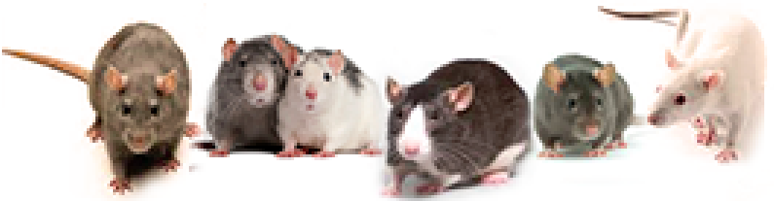
(22May2020v8)
Mapping addiction and behavioral traits: Getting close to causal variants using
GeneNetwork.org
Webinar 2
Williams RW, Centeno A, Chen H, Chitre A, Palmer AA, Prins J, Saba LM, Sen S, Sloan Z, Yousefi S, and P30 + P50 NIDA teams
Sponsored by the NIDA Center of Excellence in Omics, Systems Genetics, and the Addictome (NIDA P30 DA044223), with support from NIGMS Systems Genetics and Precision Medicine Project (R01 GM123489)
Presented by: Rob Williams rwilliams@uthsc.edu

Slide 2

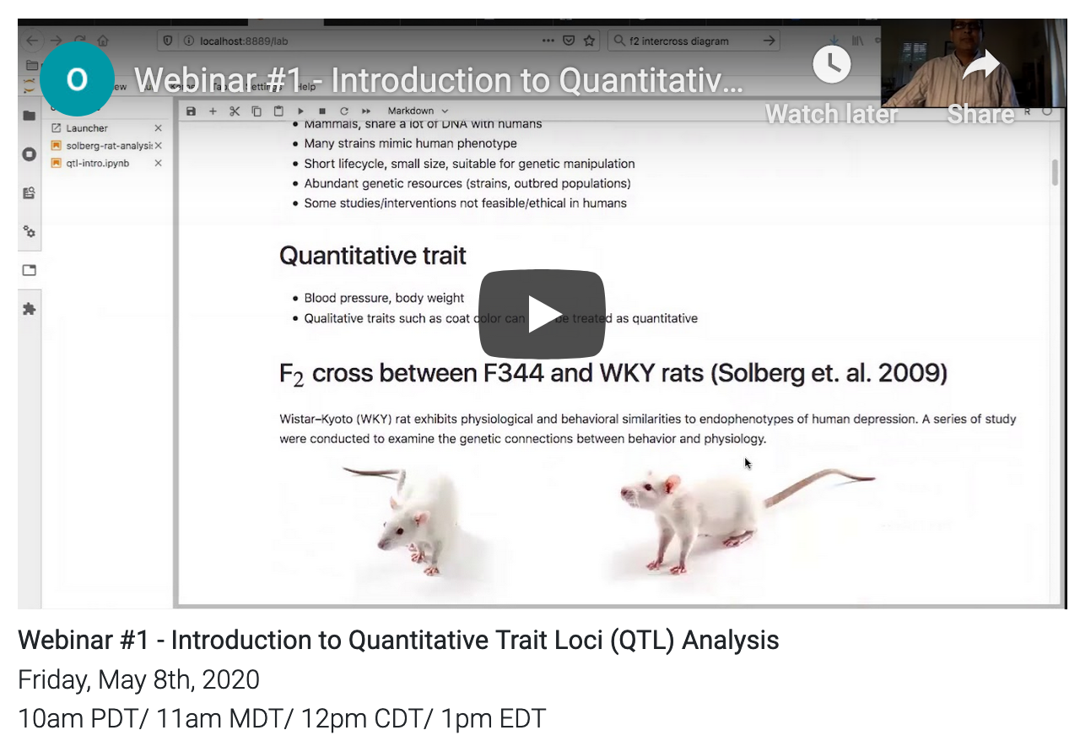
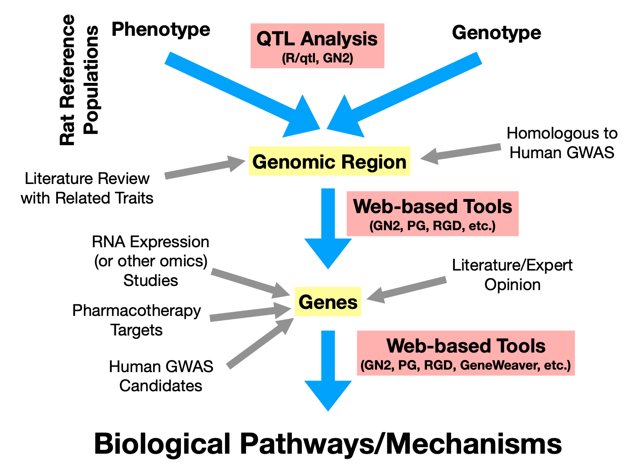
1
Quick review of rat, mouse and human molecular, SUD, and behavioral data in GeneNetwork.org
How to use GeneNetwork to review and edit trait data
How to map QTLs
How to evaluate and rank candidate genes
2
3
4
Slide 2: Introduction and ink to GitHub of 2019 course: github.com/OSGA-OPAR/SuRGe_2019

Slide 3


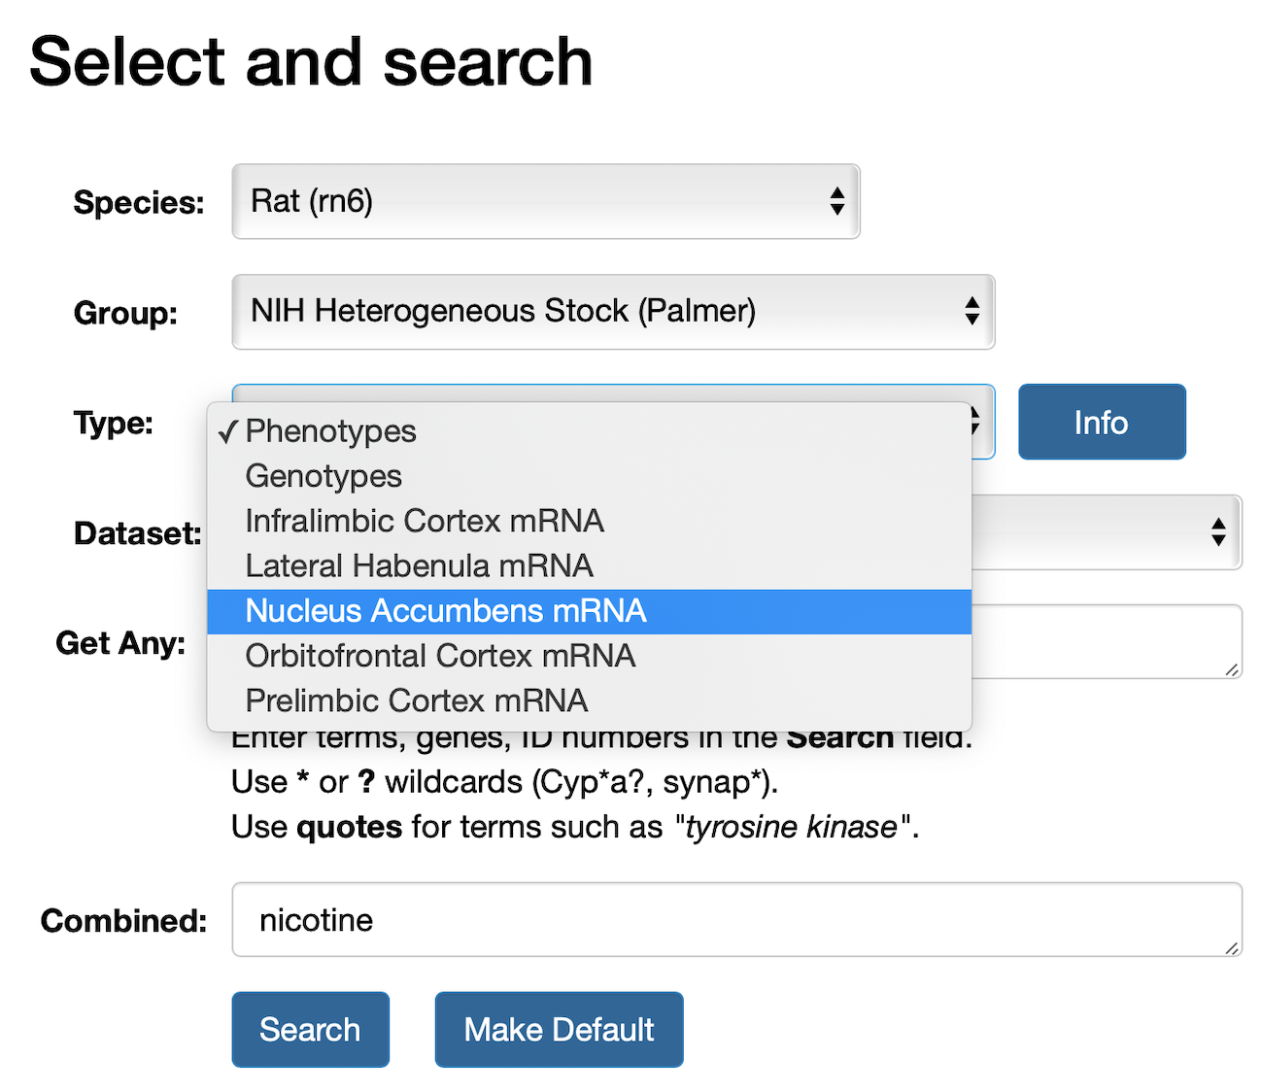
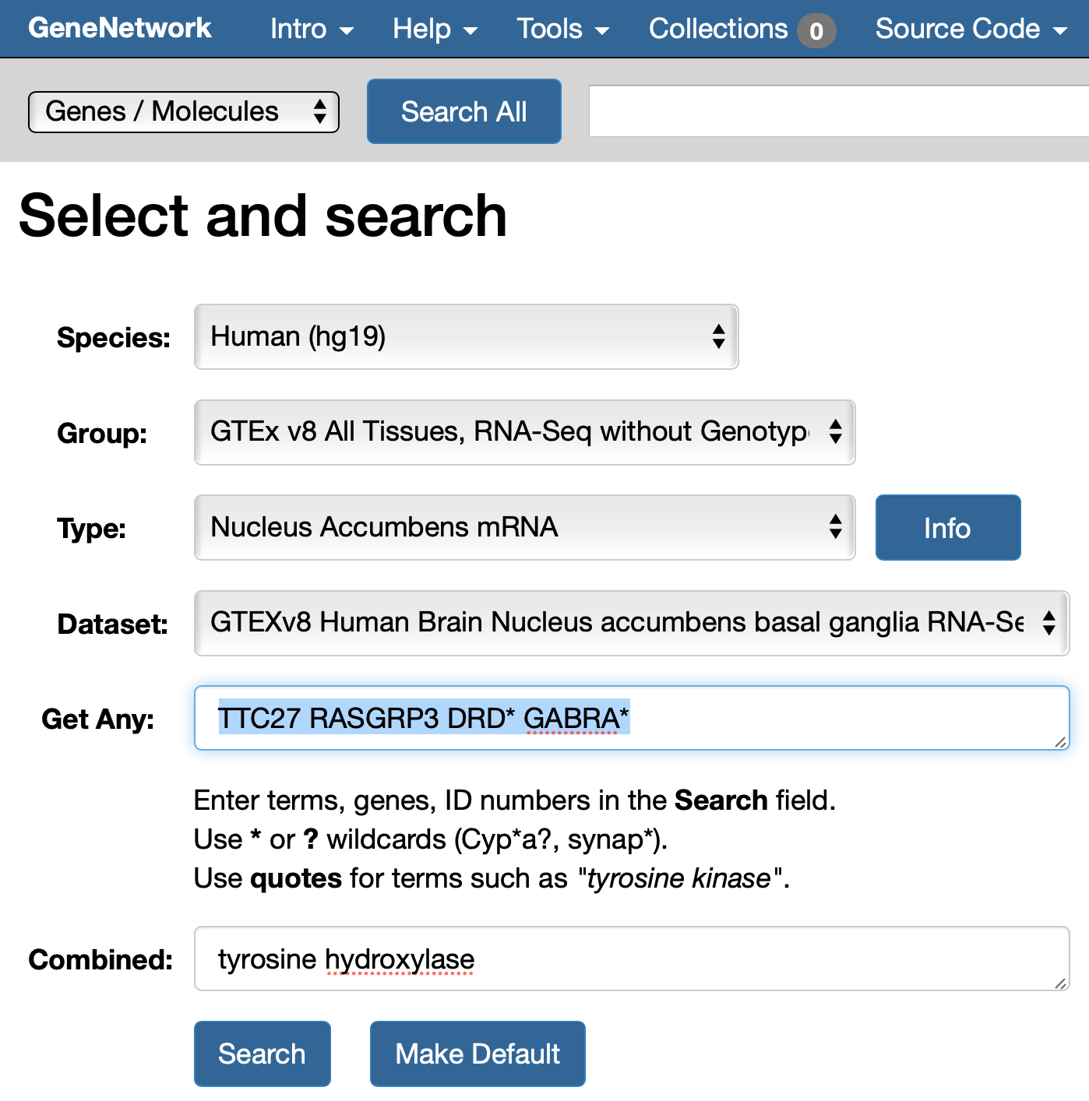
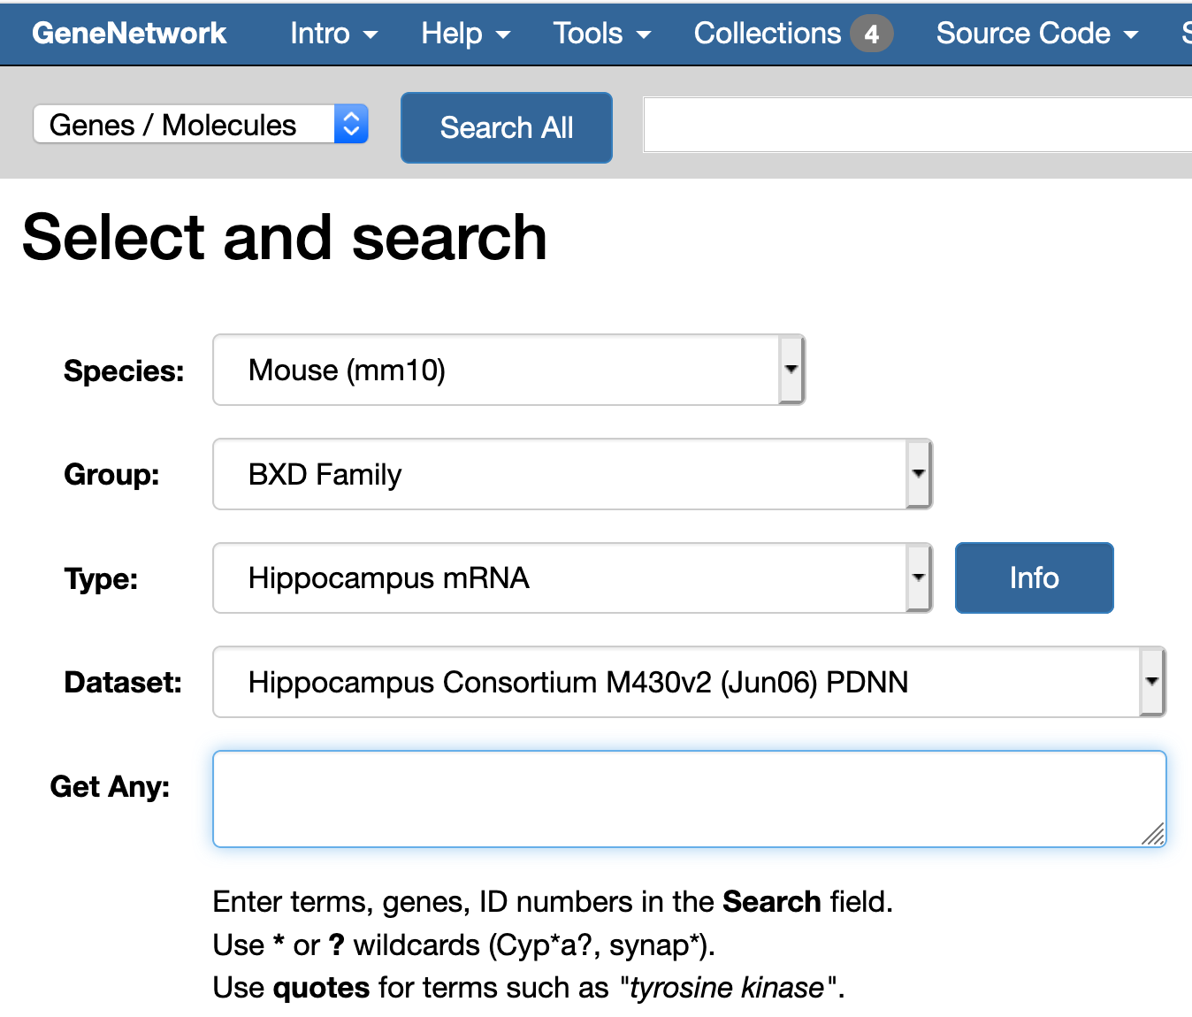
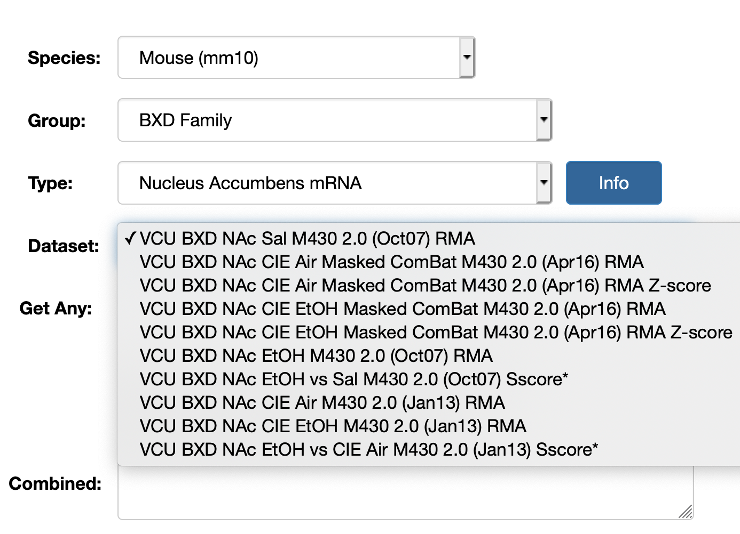
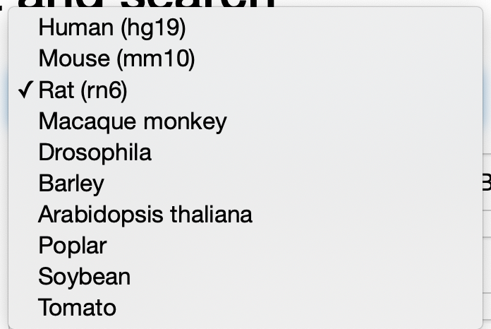
Finding data
Slide 3. Finding data

Slide 4
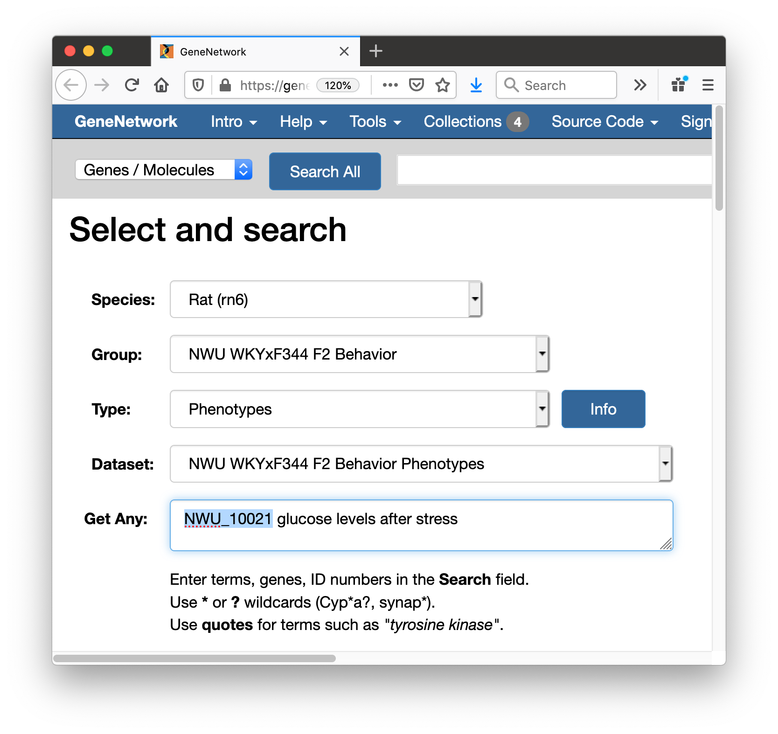
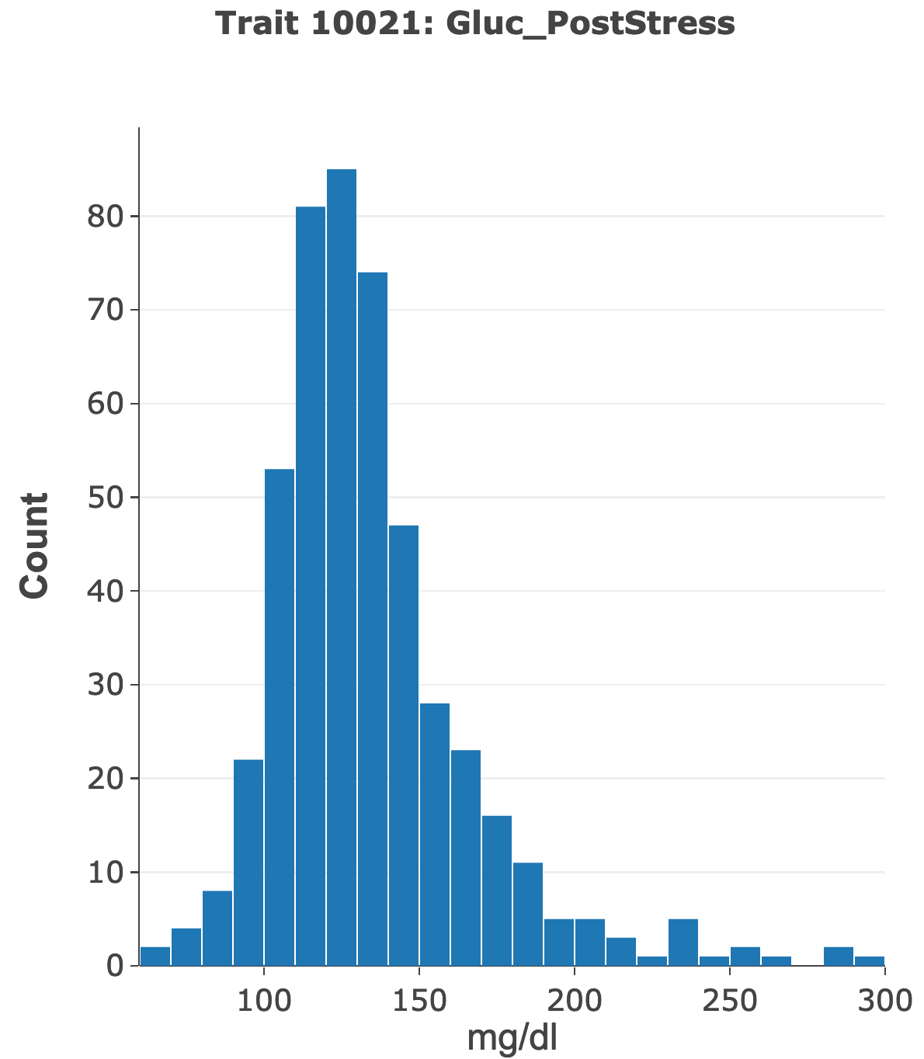
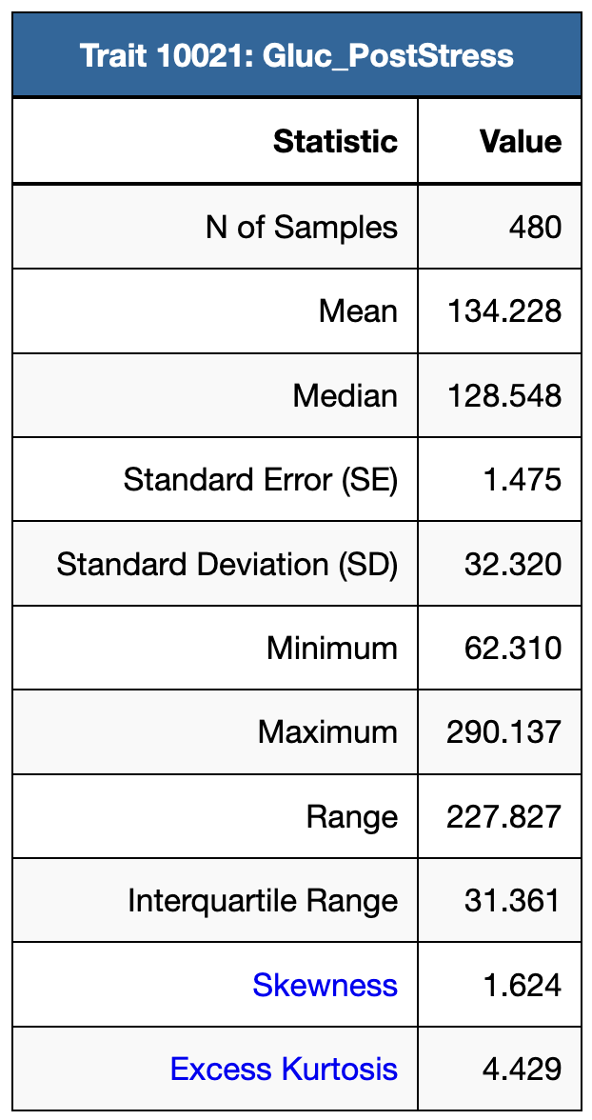
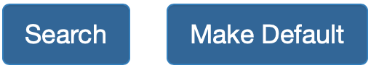
Data from our first webinar presentation by Saunak Sen
Link to www.GeneNetwork.org
We were here on May 8, 2020, but using R/qtl
*
Slide 4. Configure the Select and search page as shown. Click on Make Default. Enter a wildcard ( ) in the Get Any field (red arrow). Click on Search.

Slide 5
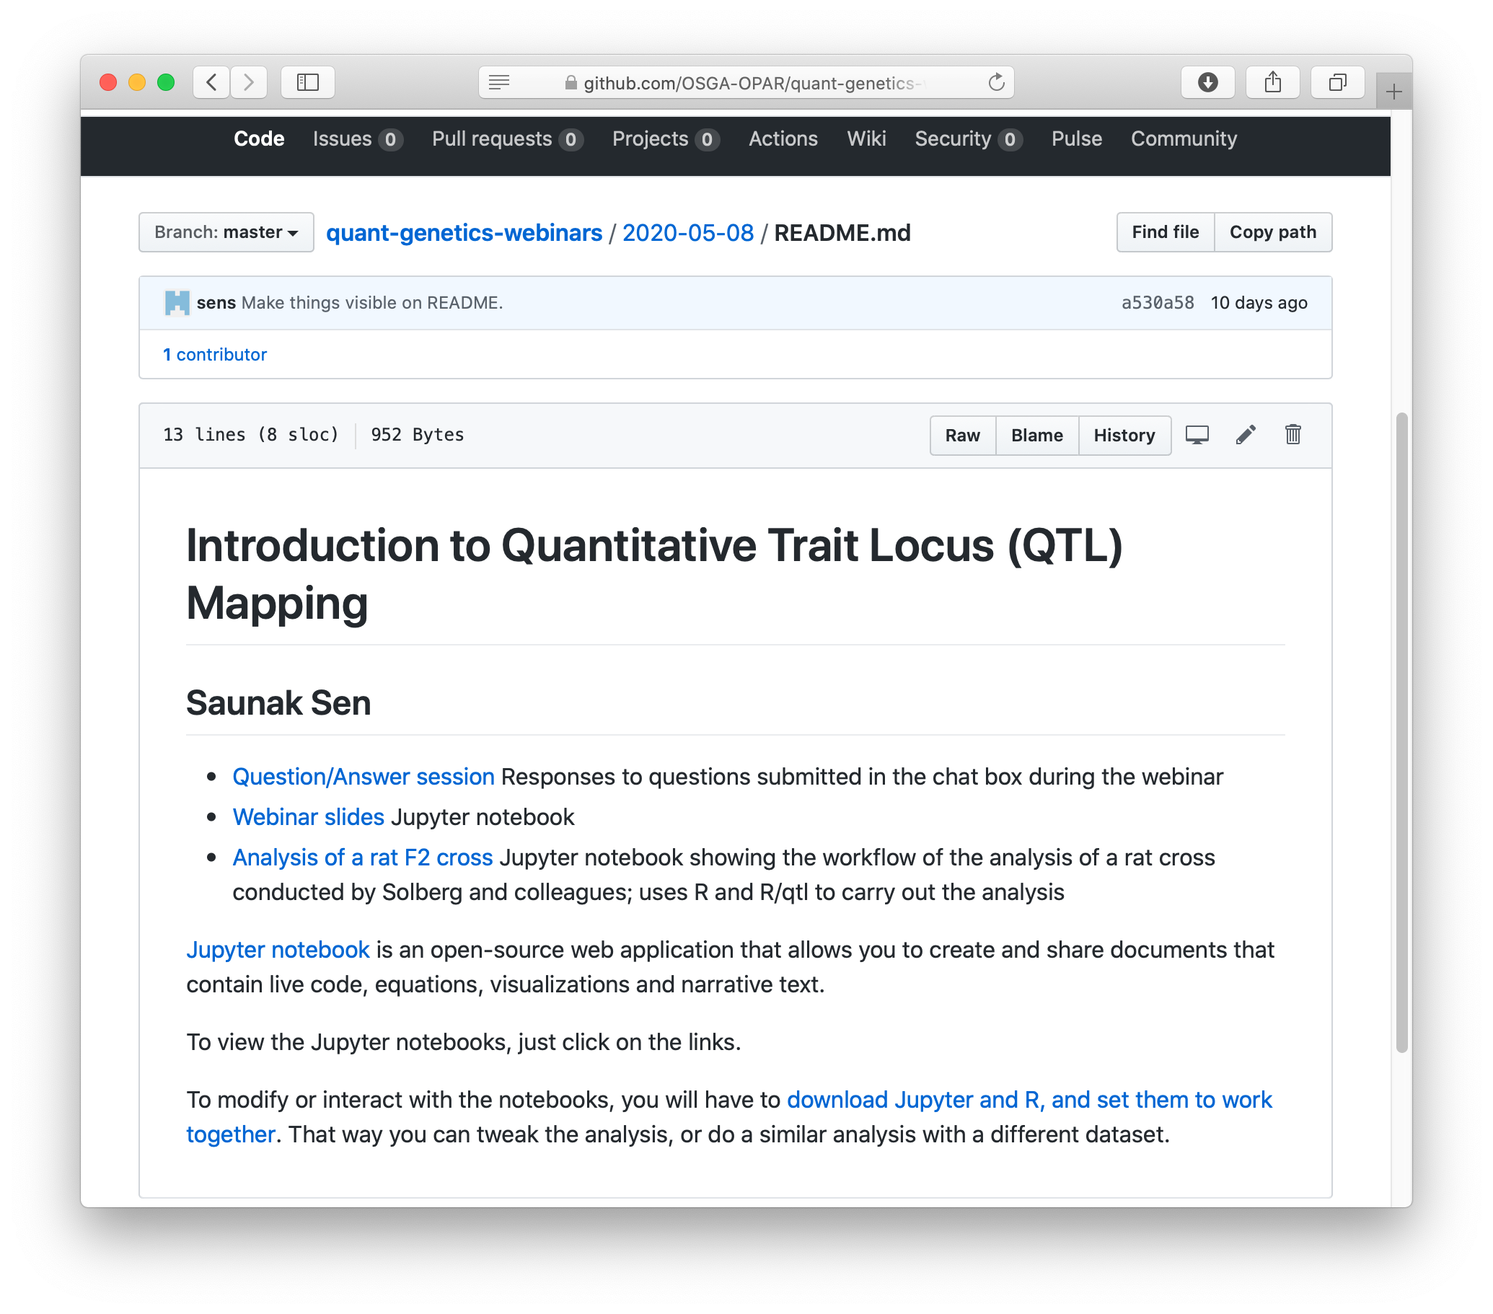
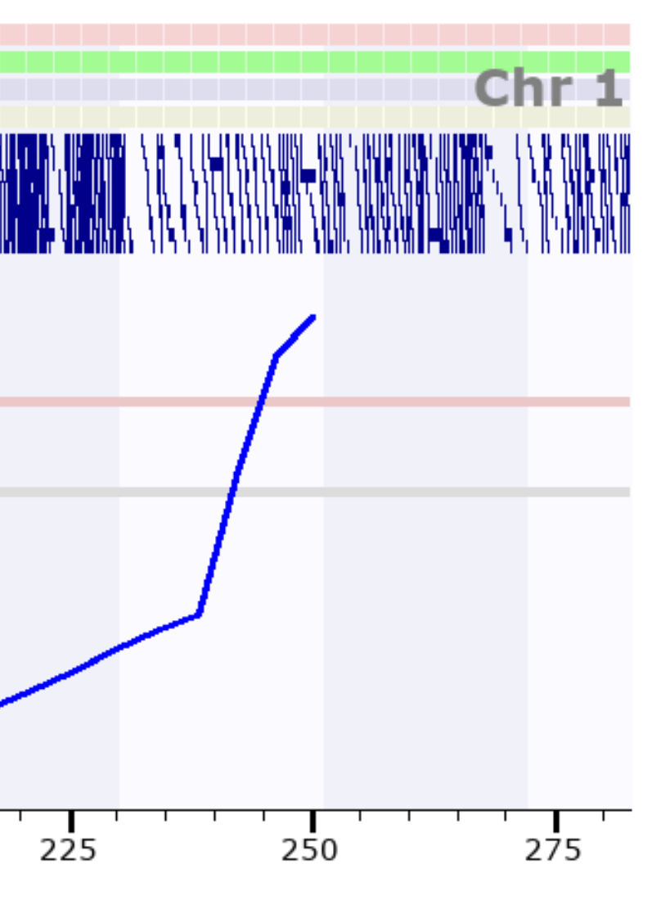
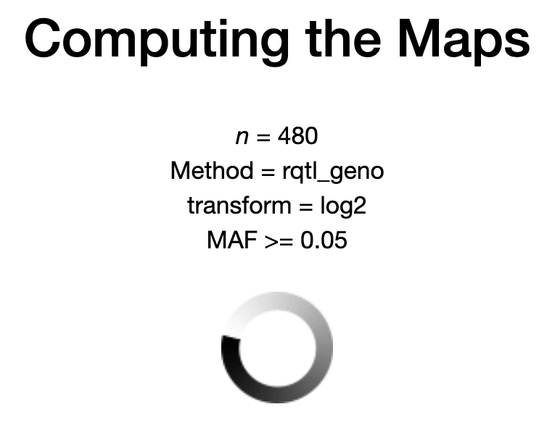
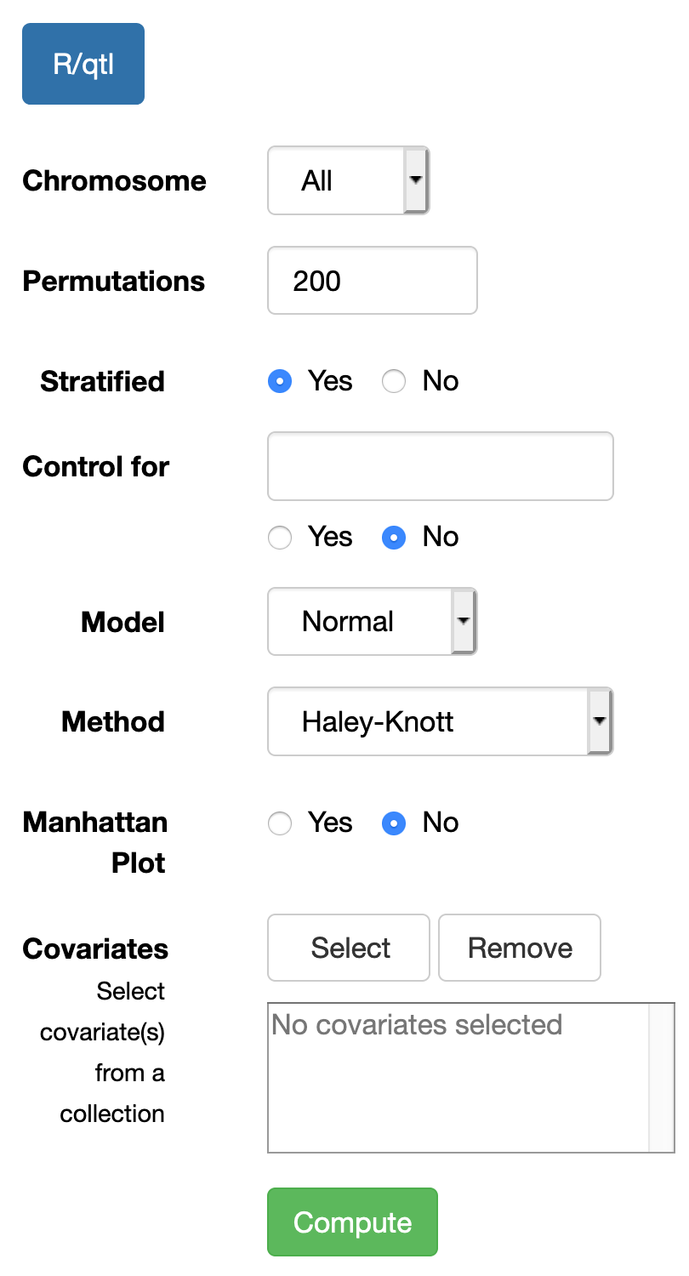
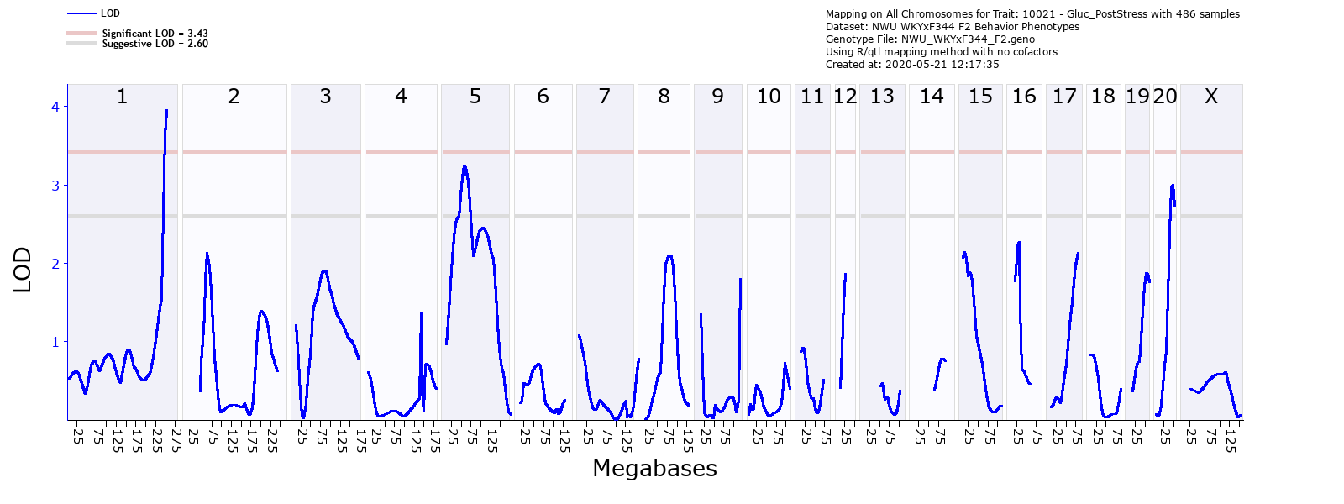
Quick review of 1st webinar on QTL mapping
http://opar.io/webinar_series_1.html
Link to course material: https://github.com/OSGA-OPAR/quant-genetics-webinars/blob/master/2020-05-08/README.md
Slide 5. Click on Compute. Just that easy.

Slide 6


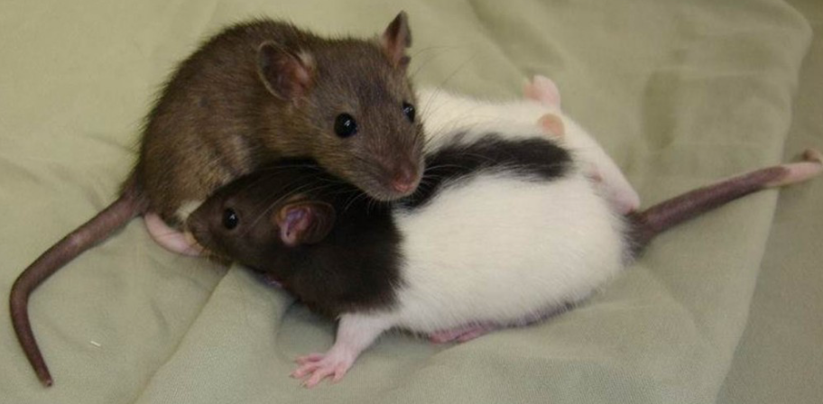
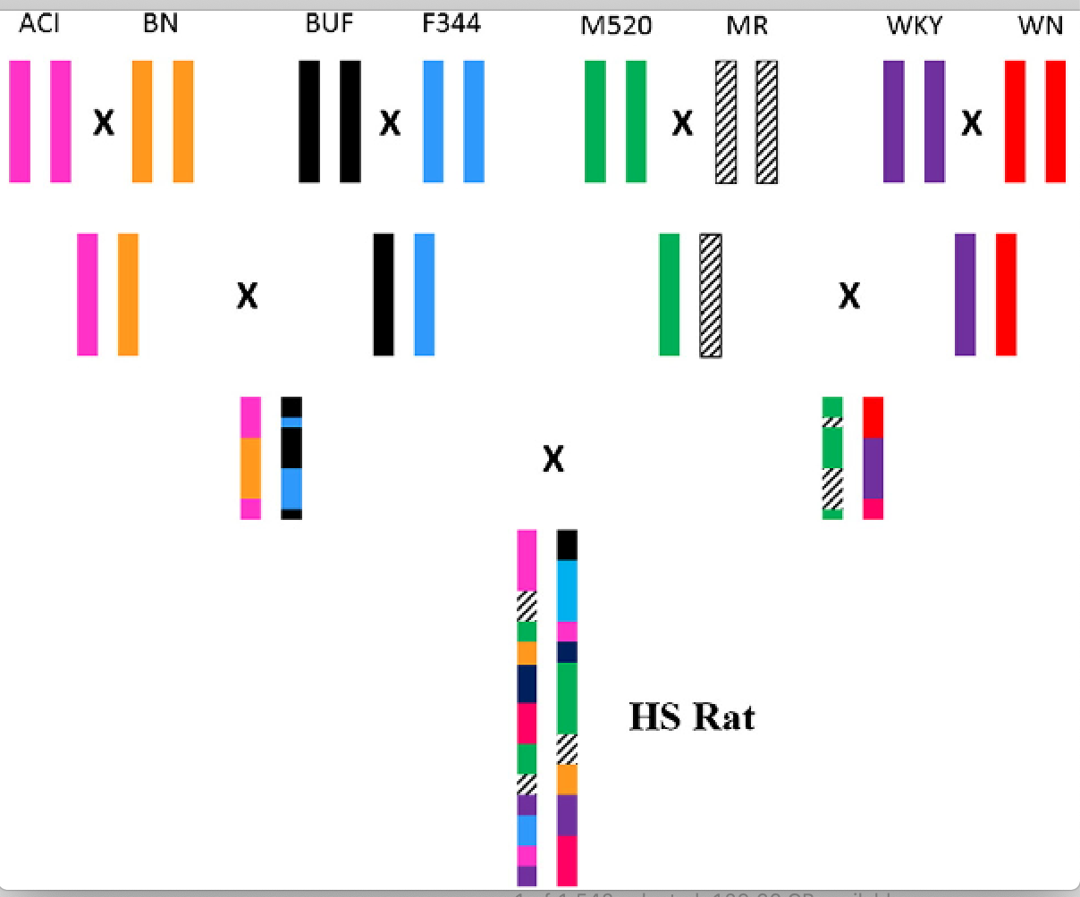
Today’s focus: NIH HS rat cross
RatGenes.org
A/A
B/B
C/C
D/D
E/E
F/F
G/G
H/H
°
Rat genome-wide mapping studies: great precision
Extensive behavioral data and RNA-seq for brain regions maintained in relational database
Very high density SNP markers (genotyping-by-sequencing)
Powerful mapping methods (GEMMA, FastLMM)
Data copied into GeneNetwork for companion analysis and for enhanced longterm FAIR data sharing.
F1
F1
1982
F1
F1
°
n =70F +70M
F2
F2
BN-MR- BUF-M520
WN-ACl-WKY-F344
°
Reciprocal G3
A=BN/SsN
B=MR/N
C=BUF/N
D-M520/N
60 pairs
12 units x 5 cages
effective population
of 120
E=WN/N
F=ACI/N
G=WKY/N
H=F344/N
°
°
Generation 87
Slide 6. HS rats—a massive family sharing 8 ur-parental strain ancestors

Slide 7
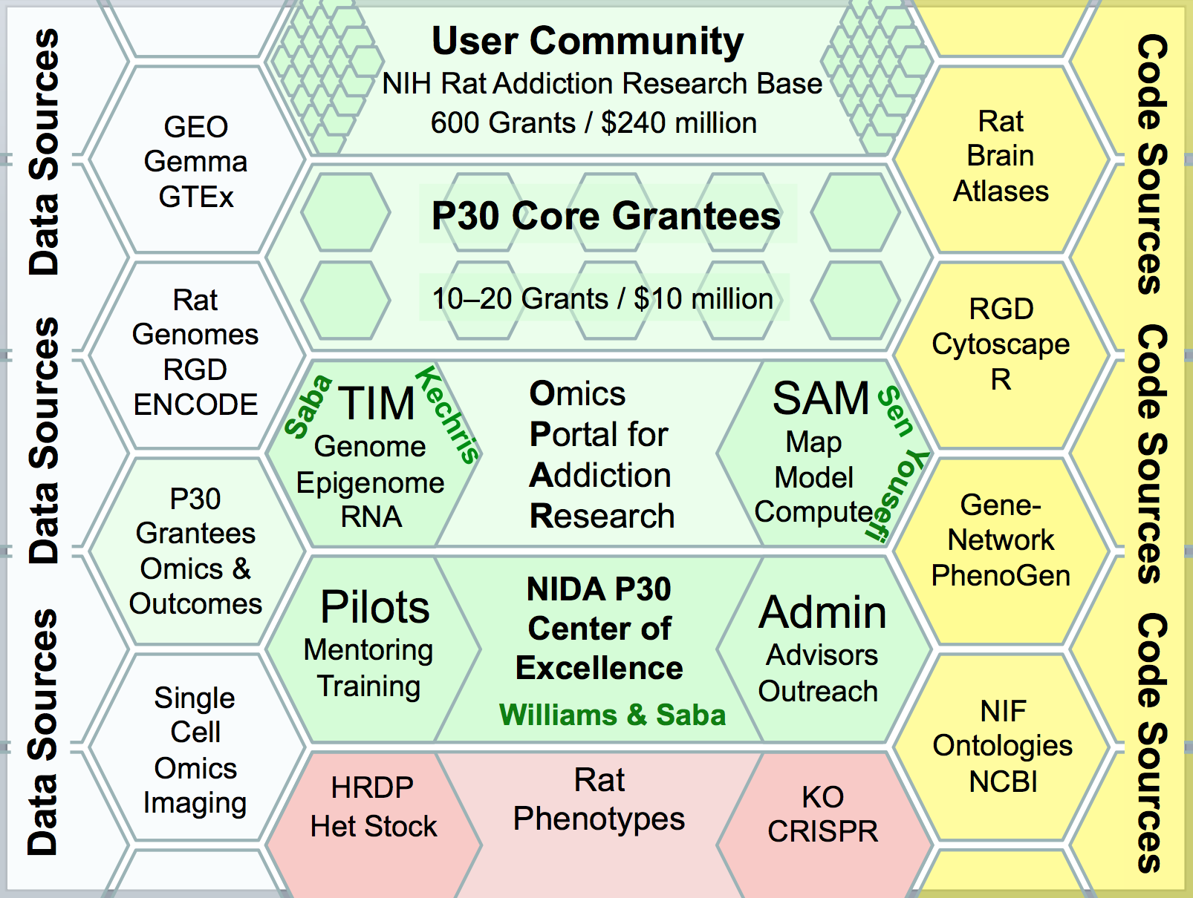
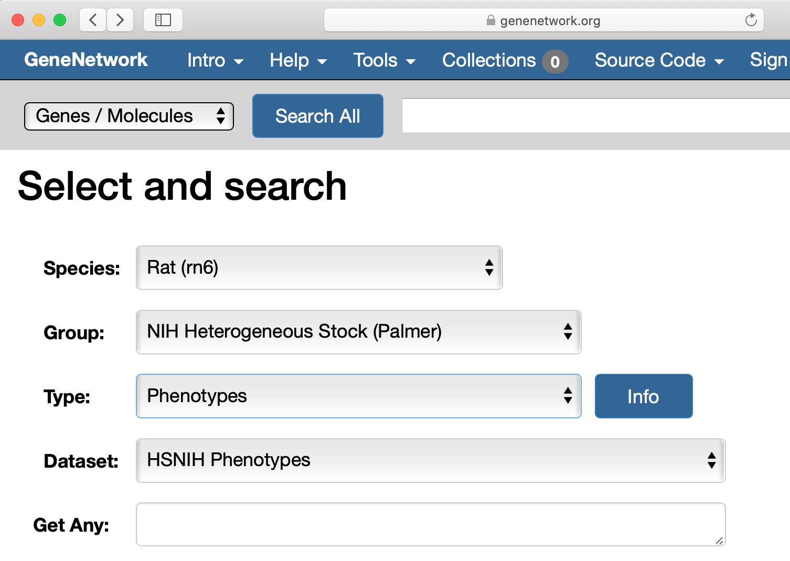
Getting to HS P50 data in GeneNetwork
Link to www.GeneNetwork.org
HS Rat
You are here
*
*
Slide 7. Configure the Select and search page as shown. Click on Make Default. Enter a wildcard ( ) in the Get Any field (red arrow). Click on Search. Just that easy.

Slide 8
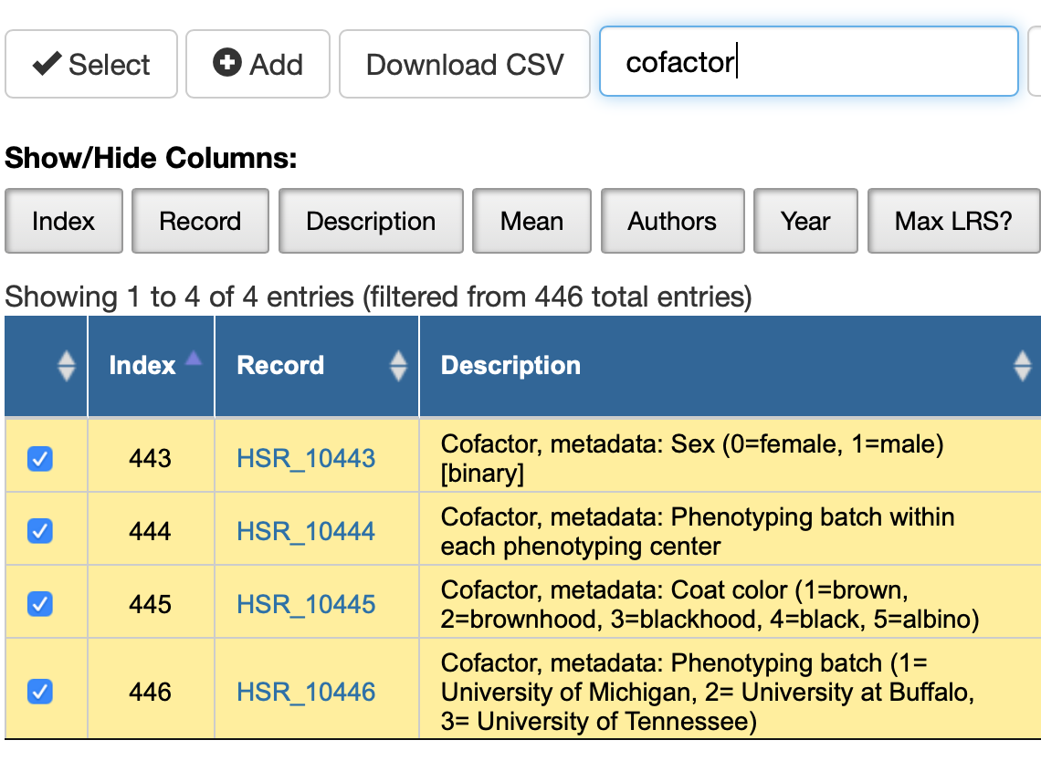
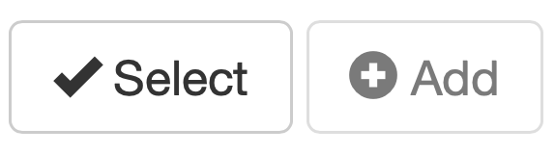
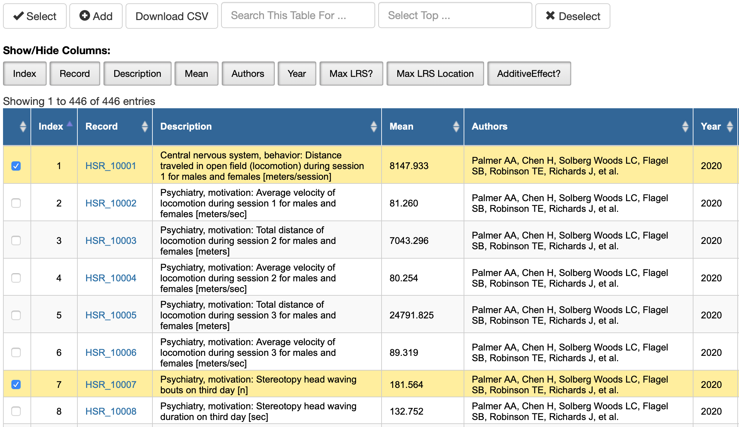
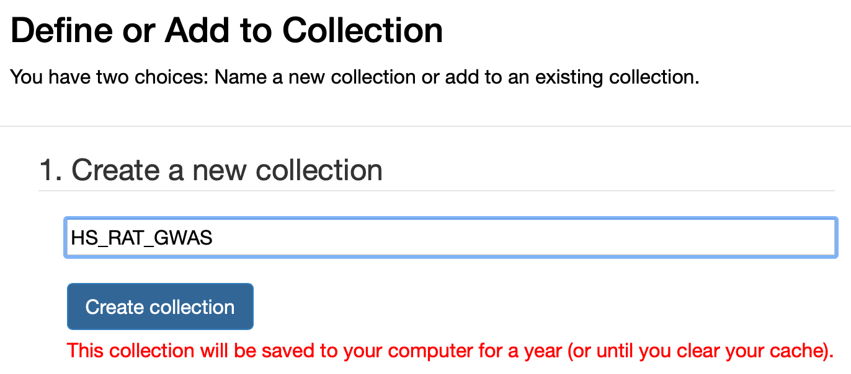
Getting HS data into Your Collection
Slide 8. Search Results. Left. GeneNetwork returns all 508 HS traits and cofactors. These traits are not yet linked to PMID citations. The Palmer AA et al. citation is often a placeholder. The Select and Add functions (top red arrow) are used in sequence to add traits and cofactors to Your Collection. Top right. Type the search term cofactor into the text field (arrow). Click on Select and Add all of the cofactors to define a Collection—bottom right—here named HS_RAT_GWAS. Collections are needed in order to use cofactors when mapping (sex, batch, site, year…).

Slide 9
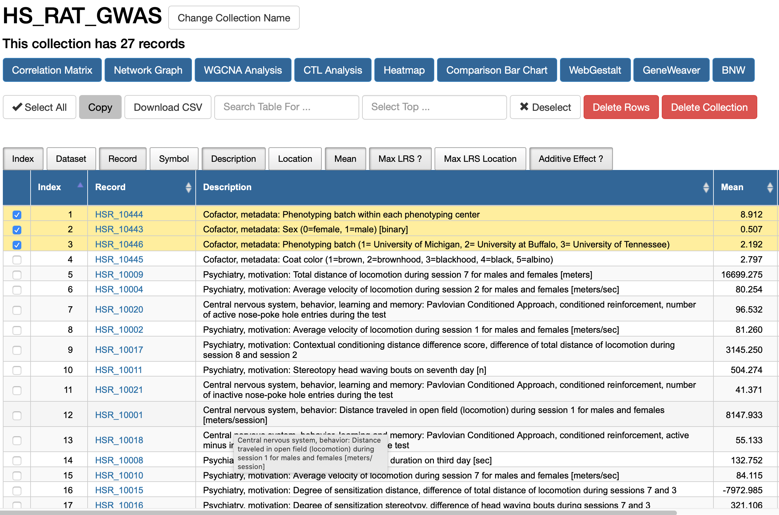
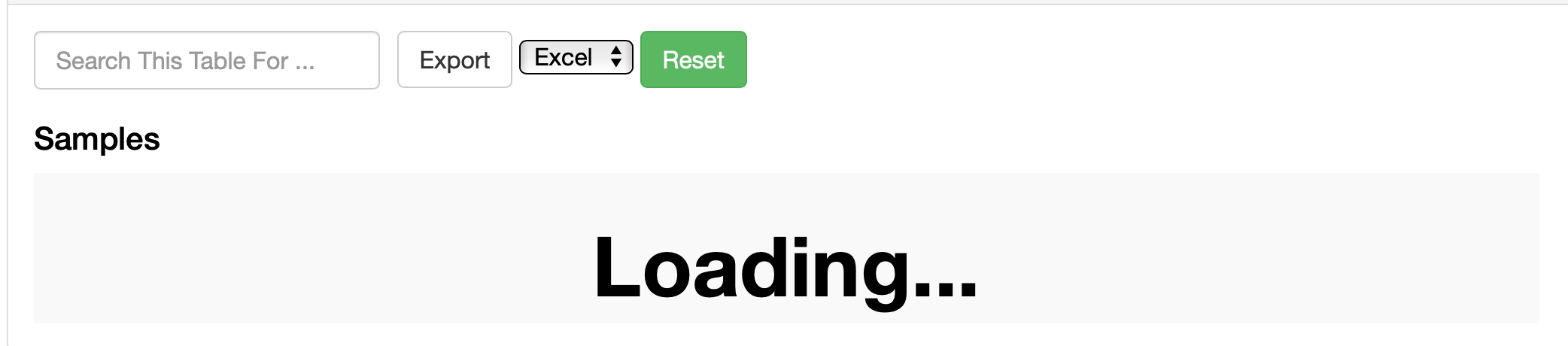
Collection of traits and cofactors
Your now have 2 collections
This link will take you directly to the HS body weight data in GeneNetwork:
http://genenetwork.org/show_trait?trait_id=10505&dataset=HSNIH-PalmerPublish
Known issue: Because HS rat GWAS data set are so large, opening some windows may take a web browser a few minutes. Don’t be surprised by this window:
2007
Slide 9. Left. The yellow highlighted rows are cofactors. Each trait has a permanent Record identifier with format HSR_10505 that are citable in papers and figures. To view data, click on blue ID numbers. Top. Collections, Tools, and Code are available from the menu. Right. Any open HS data can be accessed directly with the URL. Please be patient when loading data into your browser—the rat GWAS is one of the largest cohorts in GeneNetwork.

Slide 10
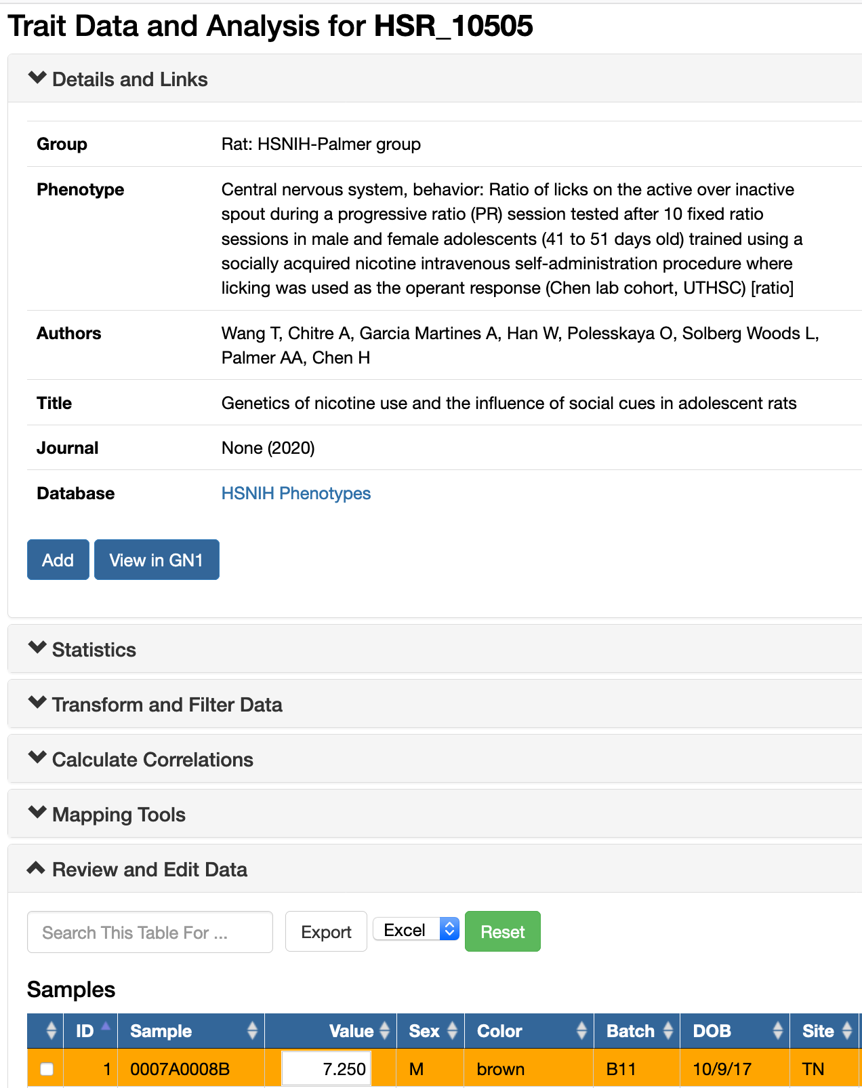
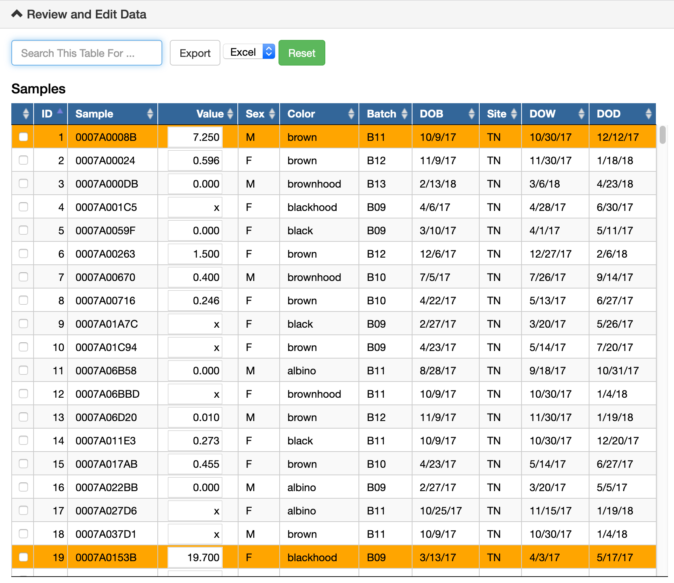
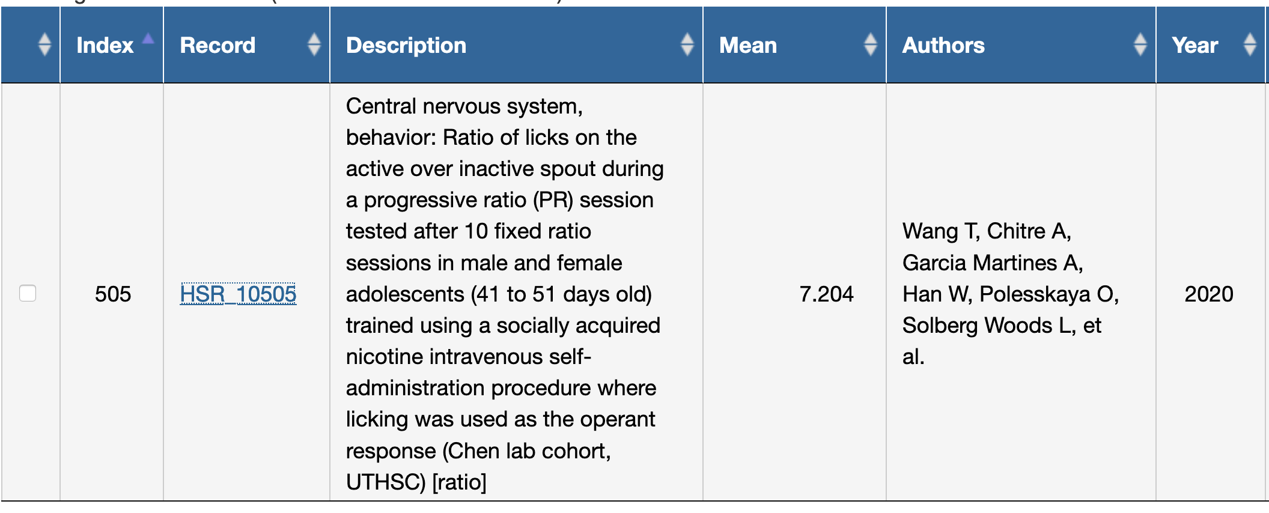
Motivation to obtain nicotine or subjective value of nicotine—in brief—seeking
Page bottom
Slide 10. Progressive ratio test, ratio of active to inactive lever presses: trait HSR_10505. Left. The top of the Trait Data and Analysis window. Right. Scroll down to review the data and cofactors. Most columns are self-explanatory. DOB, DOW, and DOD are dates of birth, experimental work, and death. In this screenshot, all individuals are shown, and for this trait, all phenotypes generated by Hao Chen and team at Site = TN
Known issue: The ITP data sets are large (13284 rows), and loading traits into browser windows may take up to 5 minutes. Sorting all rows is equally slow. We are working toward faster display methods.

Slide 11
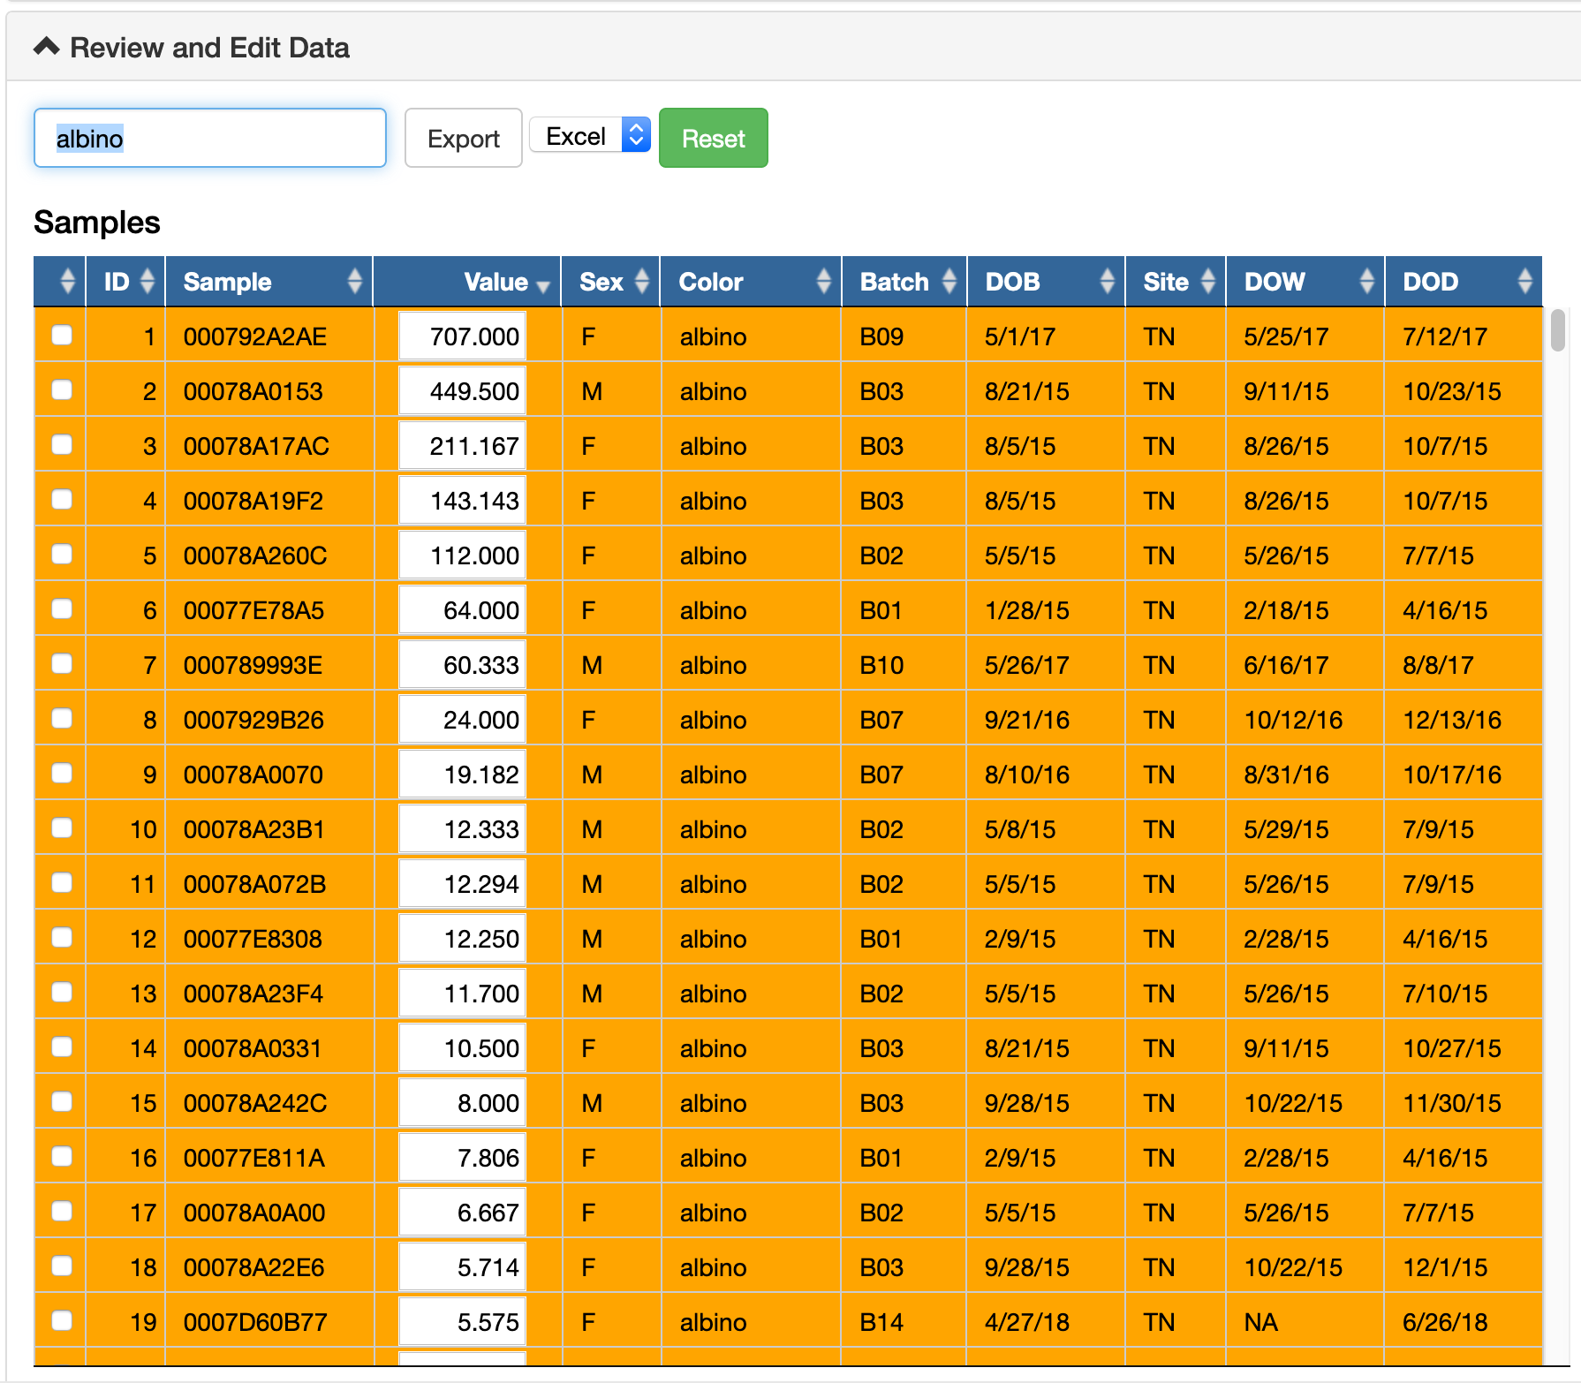
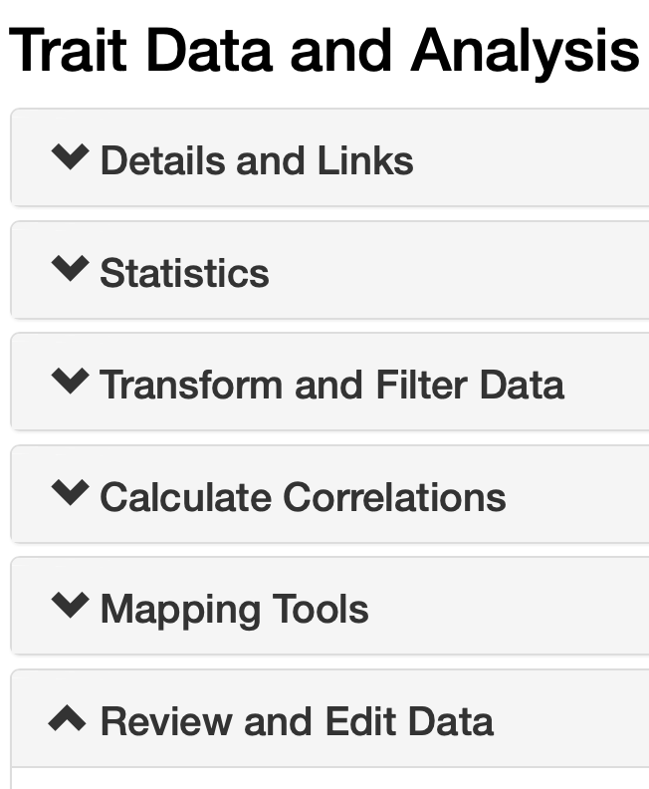
Resorting: high to low
Slide 11. Left. The Trait Data and Analysis window has six major sections. The last is Review and Edit Data (large red arrow) and is open by default. Middle. The Value column (small red arrow) has been sorted from high to low. Sorting will take a minute. Once sorted, rows of outlier cases—those with very high or low values—will be flagged as potential outliers in orange. The Value fields can be edited. You can winsorize outliers.

Slide 12
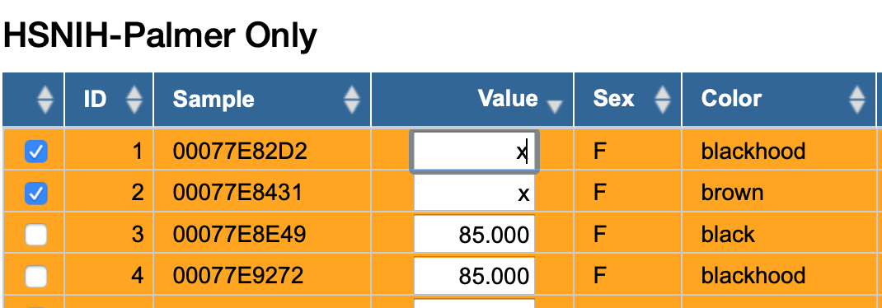
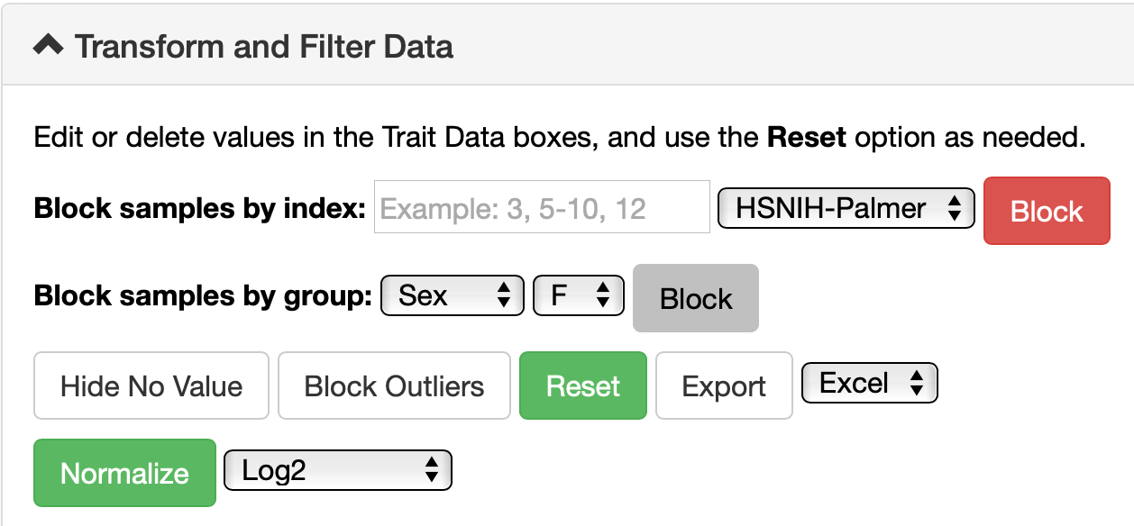
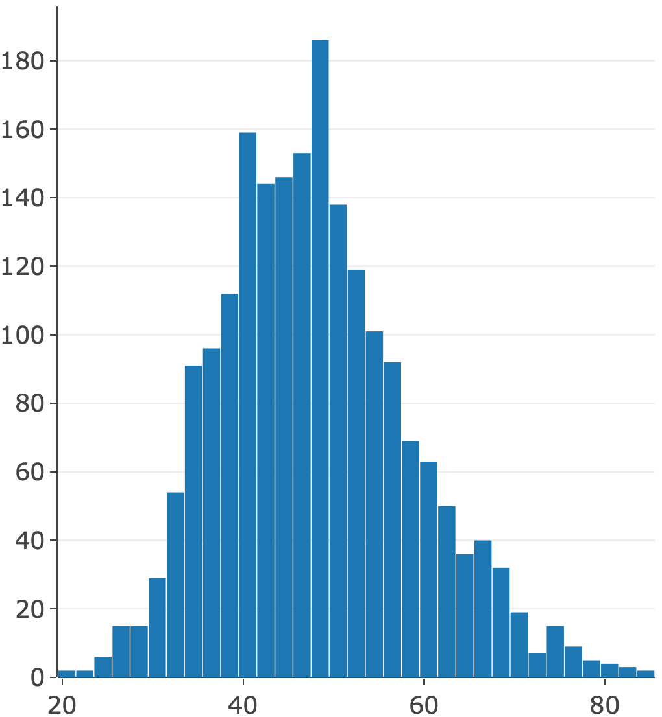
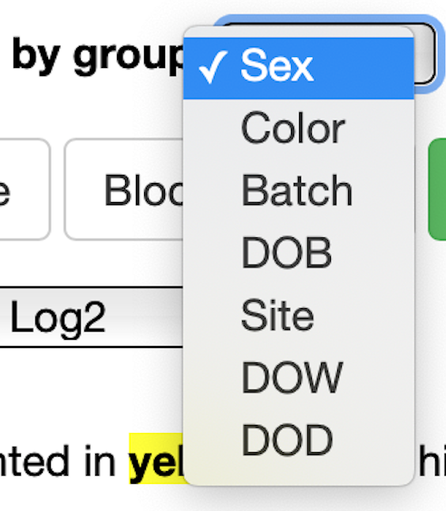
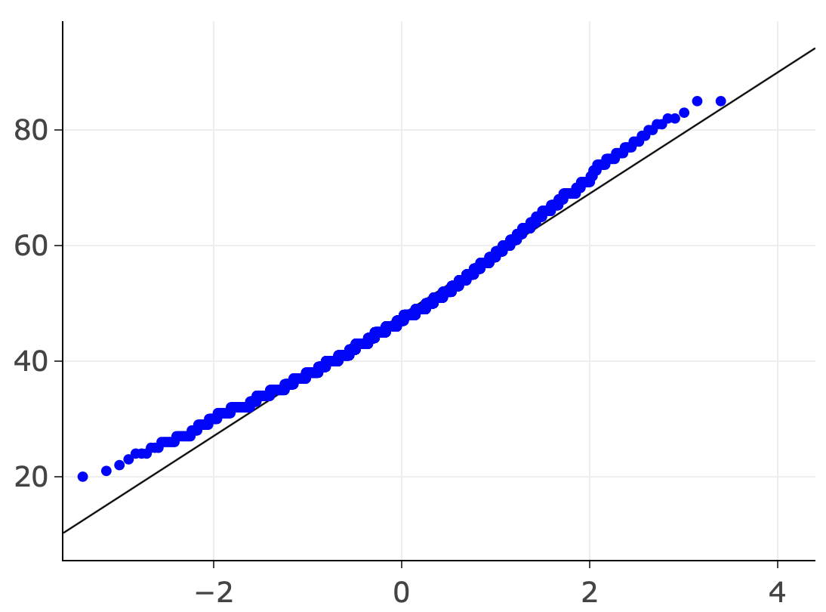

Normalizing and blocking data
Normalize by changing scales first. This affects all values. Blocking samples. Blocking is only additive.
Reset and Export
Slide 12. Normalizing and blocking. In this example the goal is to map body weight of male and female cases separately and then jointly. Left. The first step is to use the Transform and Filter Data tab functions, specifically Block samples by group: Sex = M. This action replaces male Values with an x. You can block by Site, Batch, Color. Right. Review Statistics again, especially Basic Statistics and Histogram. Censor the two highest body weights (92 and 94 g).

Slide 13
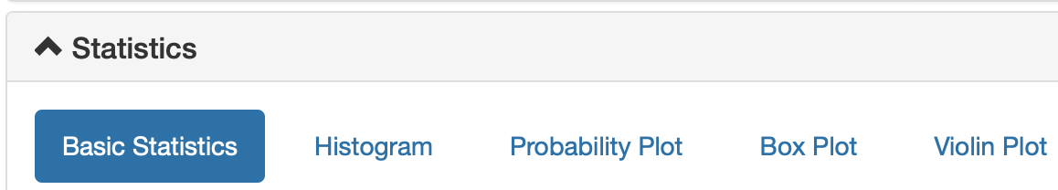

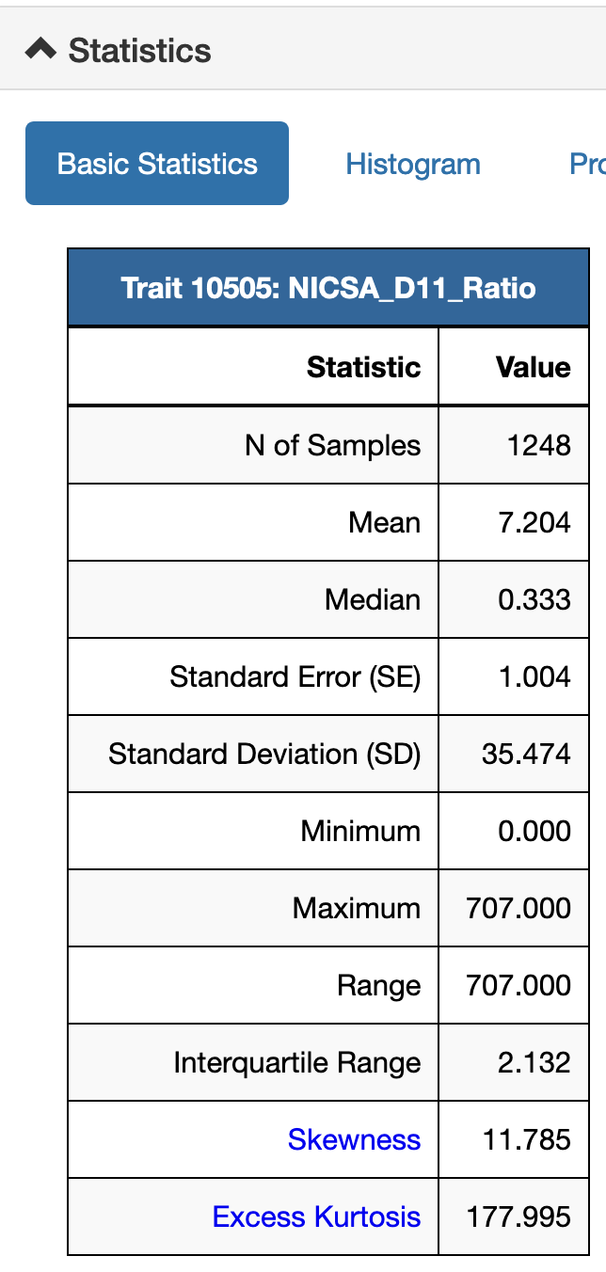
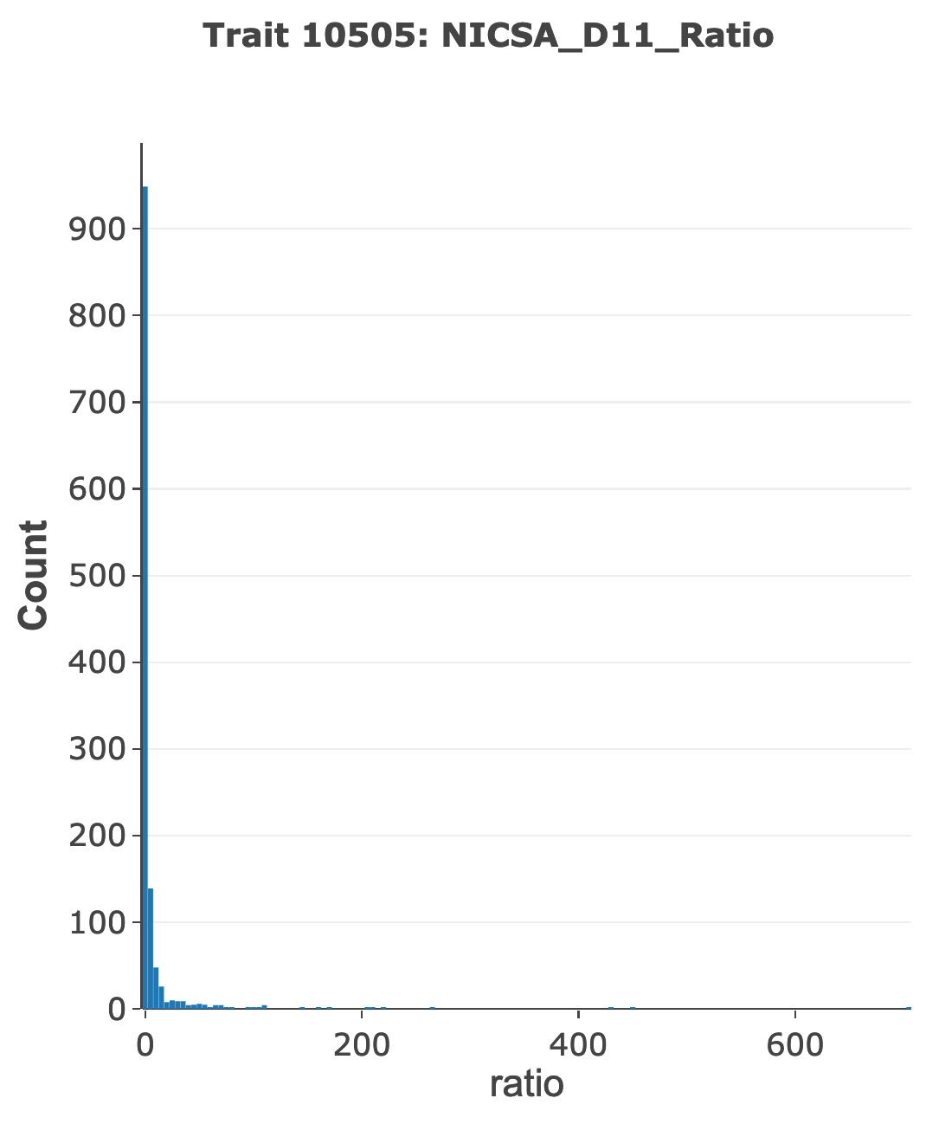
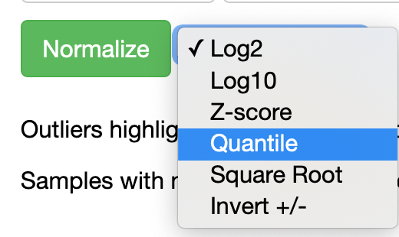
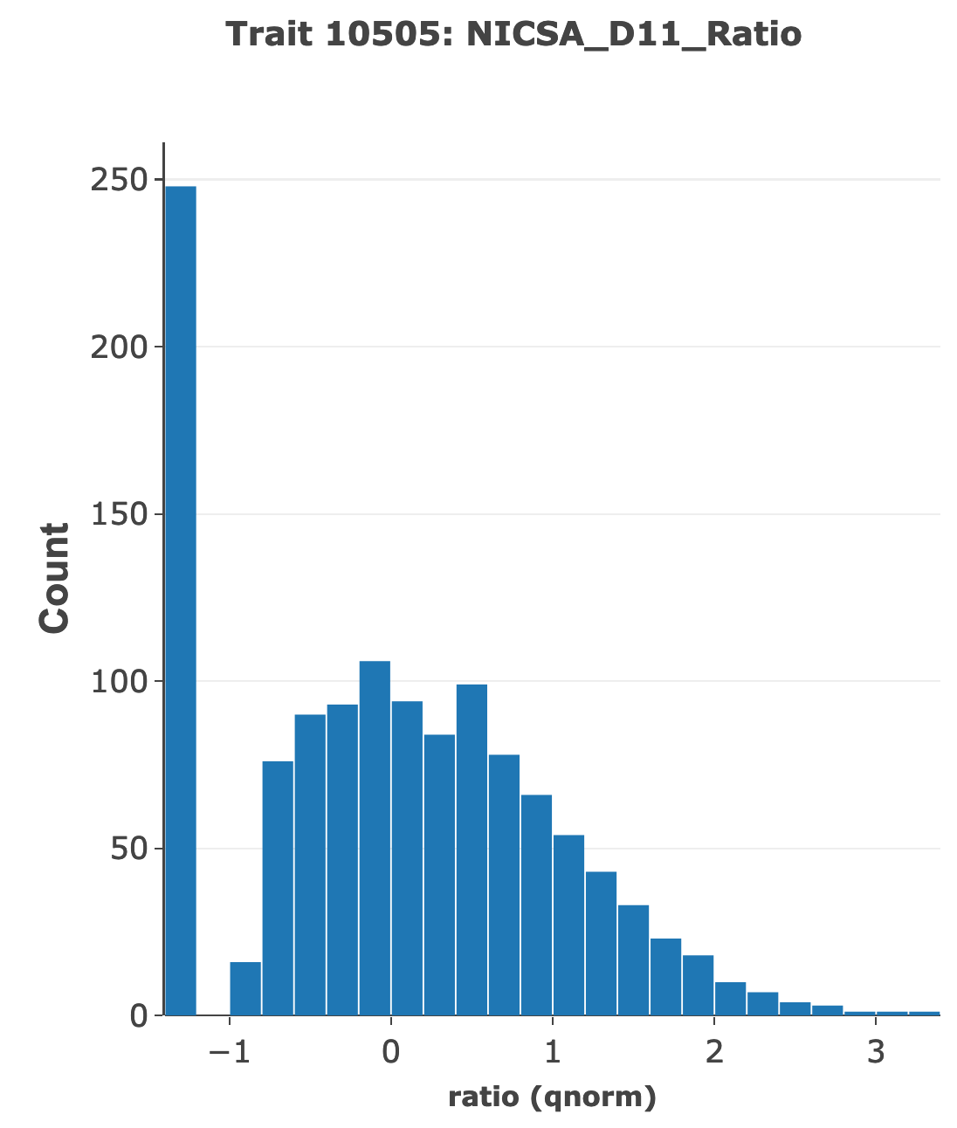
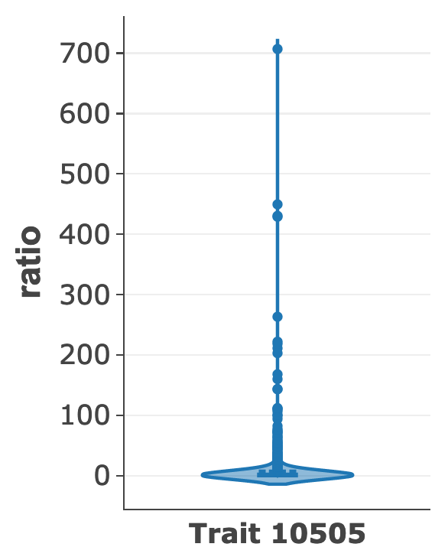
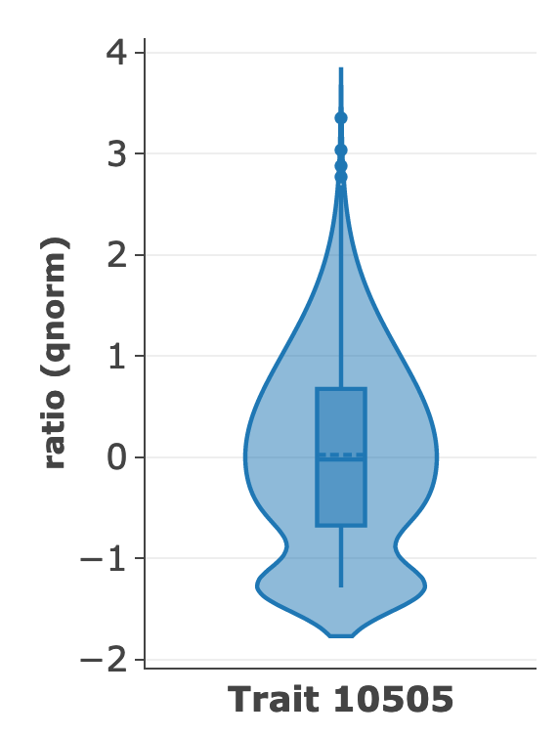
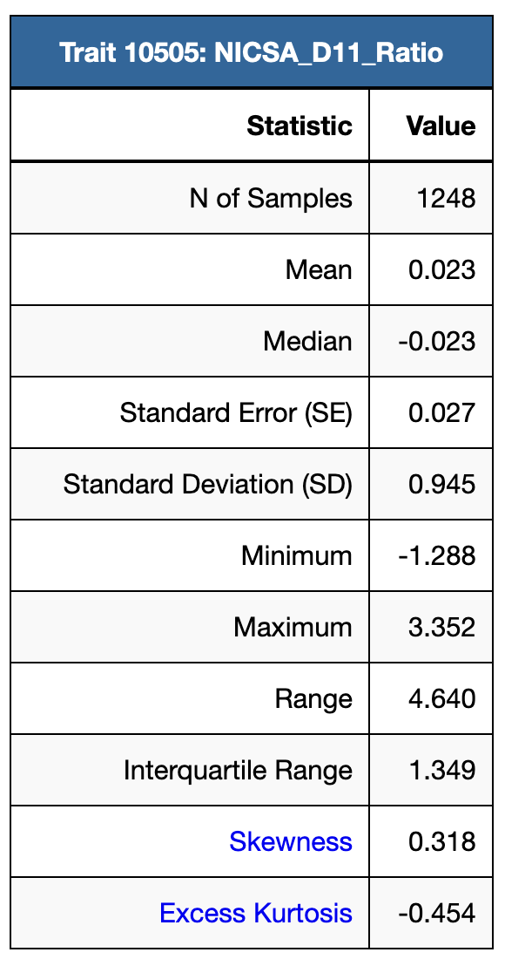
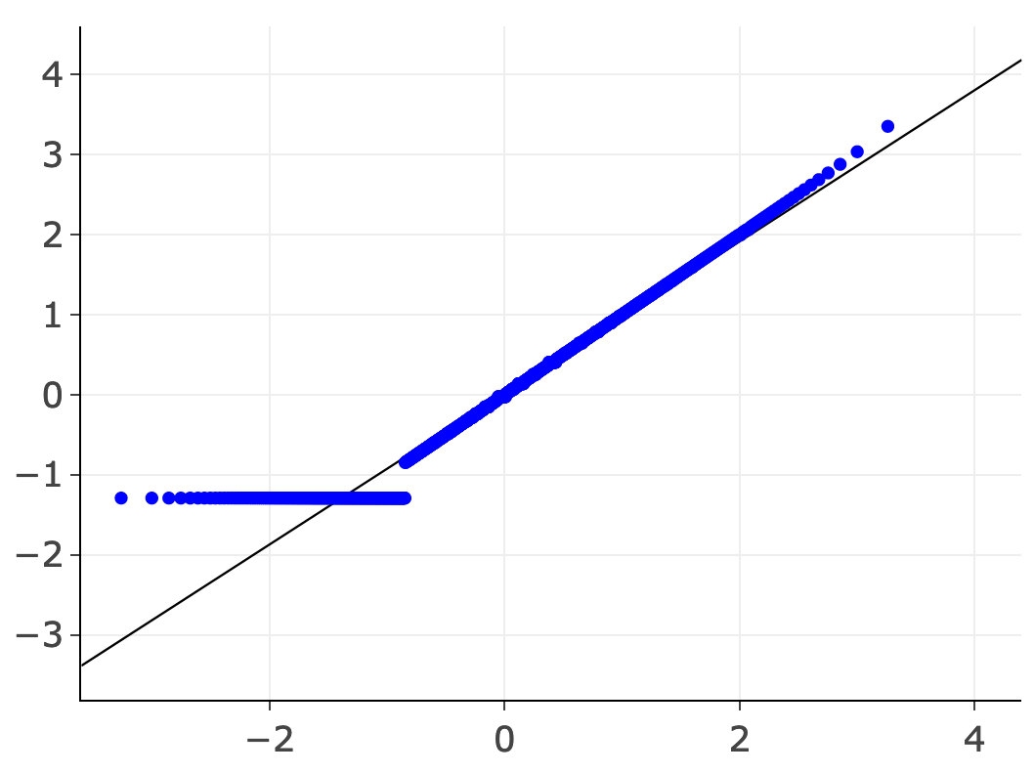
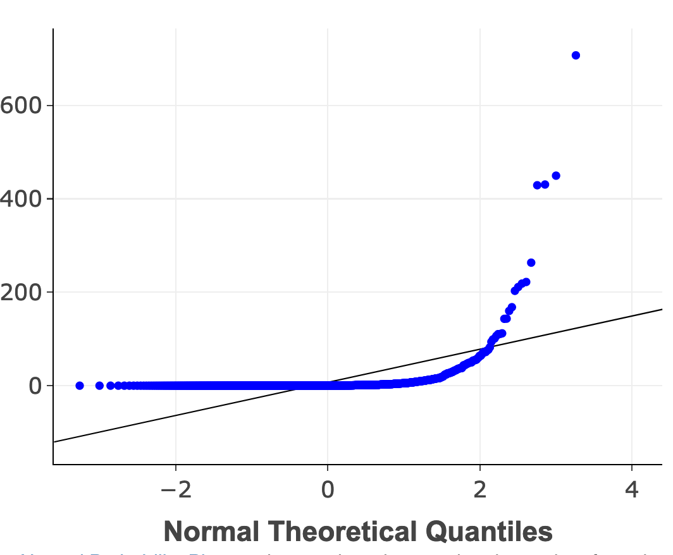
Statistics windows
All
n = 4094
Females
n = 2016
Slide 13. Left. Summary statistics. Middle. Motivation to seek nicotine measured by a progressive ratio test is skewed (non-normal) and cannot be mapped correctly using the original scale. Insets. Quantile probability plots in the two histograms, a violin plot, and statistics. Top. Graphing tools in the red box. Left. Application of a quantile transform gets data into a nearly normal form that is more suitable for mapping.

Slide 14
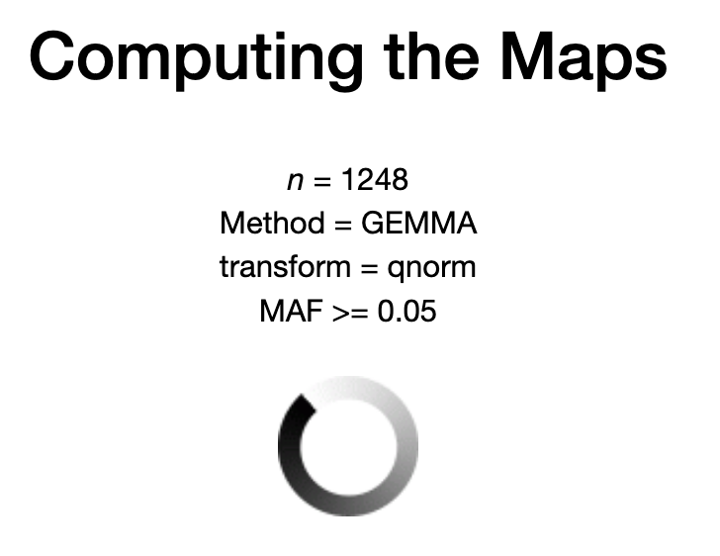
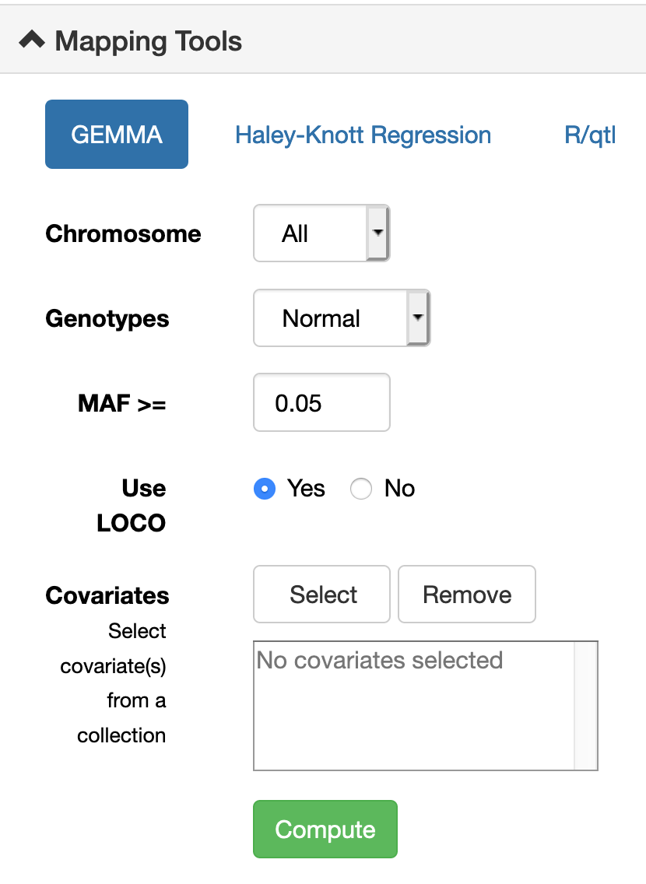
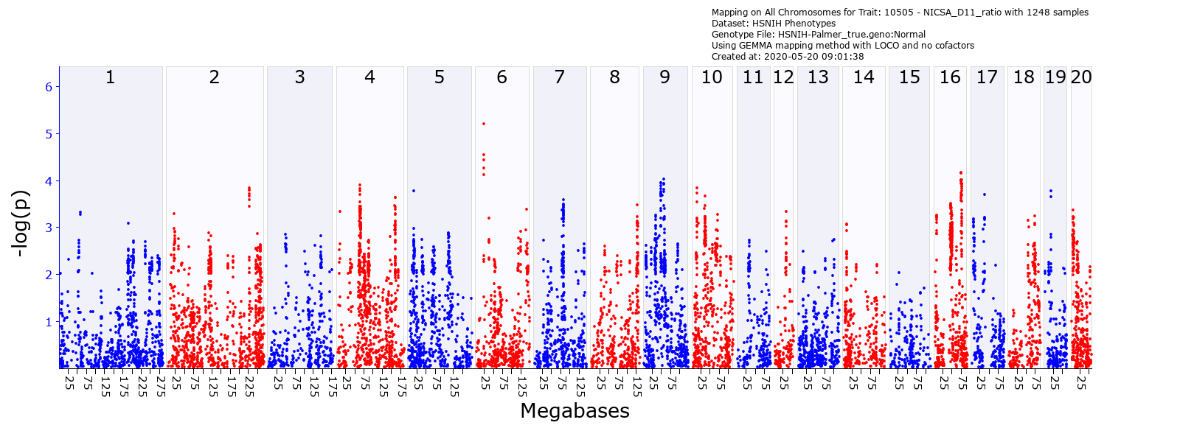
Maps for nicotine seeking motivation using GEMMA with out cofactors
Slide 14. Left. Maps for nicotine seeking without cofactors (HSR_10505). The x-axis of the map lists chromosomes on a megabase (Mb) scale. The y-axis is minus the logarithm of the linkage probability (–log p). The Chr 6 locus has a peak linkage of about 5.19. These maps can be zoomed to single chromosome level or even small parts of chromosomes.

Slide 15



Selecting covariates for mapping (all cases)
Slide 15. Mapping variation in nicotine seeking using sex and batch as addictive cofactors. We select appropriate covariates sex and batchnumber to include in the analysis from our custom HS_RAT_GWAS collection (red arrow). GEMMA or (Right) R/qtl can be used for mapping the HS. Click GEMMA Compute. Computing the Maps progress bar will appear. Time for a coffee break.

Slide 16




Maps for nicotine seeking with cofactors: sex and batch
Slide 16. Top. Linkage improve when adding sex and batch as cofactors. Peak LOD is now 5.59 on Chr 6 at 21.9 Mb.

Slide 17




Progressive zoom of the Chr 6 region of best linkage
Rasgpr3
Ltbp1
Ttc27
Birc6
Slide 17. Zoomed to a small region of Chr 6 near markers with the highest linkage scores (LOD 5.19 at 21.9 Mb.

Slide 18

Interval analyst table of Chr 6 locus
2
32.628035
Slide 18. Top. A list of genes in a 1 Mb interval.

Slide 19



The review of candidate genes begins
Addition of useful prior data
Intrusion of bias
Ttc27
The pressure of narrative potential
Slide 19. Top. Review expression of candidates in nucleus accumbens of HS rats

Slide 20


The review of candidate genes begins
Slide 20. Top. Review expression of candidates in brain regions—here in the core of the nucleus accumbens of HS rats

Slide 21



Do any of these transcripts covary?
Slide 21. Top. Review expression of candidates in brain regions—here in the core of the nucleus accumbens of HS rats

Slide 22






Relevant biology—links from GeneWiki
Slide 22. Left. Ttc27 mRNA trait page—expression data for the core of the nucleus accumbens of HS rats. Link from GeneWiki to a single PubMed article harvested daily from NCBI Gene-Reference-Into-Function (RIF).

Slide 23



Relevant biology—links from GeneWiki
Slide 23. Left. Rasgrp3 GeneWiki page. RIF link to a paper on CNS plasticity.

Slide 24


https://genenetwork.org/show_trait?trait_id=ENSRNOG00000023688&dataset=HSNIH-Rat-IL-RSeq-0818
Slide 24. Key resources
Known issue: The ITP data sets are large (13284 rows), and loading traits into browser windows may take up to 5 minutes. Sorting all rows is equally slow. We are working toward faster display methods.

Slide 25



Relevant biology—links from GeneWiki
Slide 25. Left. Ttc27 GeneMania pages.

Slide 26

Links to EBI GWAS (for TTC27)
Slide 26. Left. EBI GWAS portal page for TTC27

Slide 27

Links to PheWAS (for TTC27)
Slide 27. Left. http://pheweb.sph.umich.edu/gene/TTC27

Slide 28

Links to GTExPortal.org
Slide 28. Left. GTExPortal page of TTC27

Slide 29

Summary comments
1. Please send me bug reports or suggestions for improvements or additions
2. Please contact me if you have data sets and projects that might be suitable for entry into GeneNetwork (human, rat, mouse, drosophila....)
3. Candidate gene evaluation really needs an AI system with tunable parameters
4. We are still comparatively ignorant about the functions of most genes and their many variants and isoforms
1
Quick review of rat, mouse and human molecular, SUD, and behavioral data in GeneNetwork.org
How to use GeneNetwork to review and edit trait data
How to map QTLs
How to evaluate and rank candidate genes (at least some qualitative methods)
2
3
4
Not covered yet—should be full talk
Sequence analysis of gene variants and eQTLs within loci.
Functionally enigmatic genes: A case study of the brain ignorome
Slide 29. Summary
Known issue: The ITP data sets are large (13284 rows), and loading traits into browser windows may take up to 5 minutes. Sorting all rows is equally slow. We are working toward faster display methods.

Slide 30








Some examples
Comt
Gabra2
Fmn2
Pcdh15
Taar1
Cacna2d1
Slide 30. Successes—from QTLs to functional variants

Slide 31
Test questions
1. Find body weight data for weaning rats in the HS rats. Is the data normal enough to map?
2. The P50 Rat GWAS has several major sites. Map body weight of weanling using both sex and site as covariates. Map males and females separately and then together. How do results compare?
3. What is the correlation of expression of Drd1 and Drd2 in the infralimbic cortex of the HS rats?
4. Map stress response (corticosterone levels) 20 minutes after immobilization stress in young male rats using the HRDP HXB family AND using R/qtl. Where is your QTL? How sensitive is the result to different data transformations?
5. Organize and rank a list of genes within the QTL for the serum cort level QTL. (Or is it too big to bother with?)
6. Map morphine locomoter response 45–60 minutes after an injection of 50 mg/kg in male and female BXD mice. Define the best candidate gene.
https://genenetwork.org/show_trait?trait_id=10441&dataset=HSNIH-PalmerPublish
https://genenetwork.org/show_trait?trait_id=10061&dataset=HXBBXHPublish (LOD 4.37, Chr 11 at 69–78 Mb, ~120 genes)
https://genenetwork.org/show_trait?trait_id=11845&dataset=BXDPublish
Slide 31. Test question examples
Known issue: The ITP data sets are large (13284 rows), and loading traits into browser windows may take up to 5 minutes. Sorting all rows is equally slow. We are working toward faster display methods.

Slide 32







Statistics windows
All
n = 4094
Females
n = 2016
Slide 32. Statistics. Left. Summary table. Middle. Histogram of weanling weight generated using the Statistics Histogram tab. Insets. Quantile probability plots in the two histograms, a violin plot, and statistics. Top. Graphing tools are highlighted in the red box: Edit, Pan, Zoom In, Zoom Out, Autoscale, Reset, Export SVG, and Export JPEG. Left. Histogram of 2016 females. To analyze only females, Block samples by group: Sex = M

Slide 33

Maps for body weight with cofactors with GEMMA (about 45 minute job)
Slide 33. Top. Maps for both males and females with three cofactors: batch, sex, and center (HSR_10443, 10444, 10446). The x-axis lists chromosomes on a megabase (Mb) scale, except Chr X and Y. The y-axis is minus the logarithm of the linkage probability (–log p). The Chr 14 locus has a peak linkage of about 6.4. These maps can be zoomed to single chromosome level or even small parts of chromosomes.

Slide 34

Edit in ChartStudio to get publication quality
Slide 34. Any of the statistic plots generated by Plotly can be modified in Chart Studio. Click on the Edit pencil icon. In this example, a default histogram has been modified in many small ways, including bar color, axes labels, tick marks, and the x-axis has been modified to show bins between 10 and 90 grams only. Free.

Slide 35



HS genotypes are complex
Mb
genenetwork.org/show_trait?trait_id=chr6:21892556&dataset=HSNIH-PalmerGeno#redirect
Value 1: n = 259
Value 0: n = 2472
Slide 35. Left. Table of the –log p linkage scores sorted from high to low by marker and position. The highest score for body weight is 6.4 on Chr 14 at 16.851818 at Mb. Middle and Right. A 1.5 confidence interval drop in both proximal (top arrows) and distal (bottom arrows) directions from the peak is used to define an approximate confidence interval (CI). Sets of red arrows mark approximate 1.5 CIs.

Slide 36


Stratified permutation testing
Mb
4.64
Slide 36. Left. Peak linkage computed for 2000 stratified permutations of phenotypes within cofactors when using R/qtl. In this example, only 15 of 2000 permutations have LOD peaks greater than 4.64. The genome-wide alpha of linkage to Chr 11 is therefore p <0.01. Right. The permutation results can be downloaded as comma-separated-value text files. Here data have been entered into Excel to highlight the few permutations that exceed the value of the locus of 4.64. Note that each permutation run will provide somewhat different thresholds. Before publication compute thresholds using at 1000 – 2000 permutations—currently an overnight calculation of HS rats.

Slide 37











HS expression data in GeneNetwork: a ton of RNA-seq data
NAc
NAc
NAc
NAc
Nurr77
Chrna4
Scn4b
Ntsr1
Fosb
Arc
Nr4a2
Nr4a2
Nurr1
Nurr1
NAc
NAc
NAc
Prelimbic
? r
? r
Slide 37. Left. The same tools work with all HS omics data. Expression distribution require care, but are highly revealing. What are the correlations of Arc to Fosb in nucleus accumbens (Nac)? What is the correlation of Nr4a2 (aka Nurr1) in NAc and prelimbic cortex (red bimodal histogram)?

Slide 38




HS expression covariation: 4D scatterplots of Pearson r and Spearman rho
Fosb
Arc
Slide 38. Left. Arc and Fosb are both immediate-early genes and have Pearson’s correlation of 0.7. Males in blue, females red, and the batches as circle size 1, 2, 3, 4. Right. Spearman rank correlation of 0.44 between the key dopaminergic gene Nurr1 (aka Nr4a2) in prelimbic cortex (x-axis) and NAc (y-axis).

Slide 39



Nr4a2 expression in prelimbic cortex: what other genes covary?
Nr4a2
Prelimbic
Slide 39. Correlation of one transcript with all others. It is possible to set a minimum threshold of 5 log2 units.

Slide 40

Technical conclusions (mainly for P50 team)
Crf_MI
01Apr2020
P50 reports rock
Much of the mapping workflow is in place. We need smoother data and metadata entry methods.
The HS Rat GWAS data and genetic analysis is FAIR-compliant in GeneNetwork.
All code is accessible on GitHub https://github.com/genenetwork/genenetwork2.
You can replicate and tweak models when mapping any of the P50 traits. You can do this on your own without much hassle.
It is a short step from the P50 reports you get from Apurva to the P30 reports you can generate in GN. Our goal is to make sure these reports converge perfectly (replicable work flows).
As the rat genome assembly and sequence data for the eight parents of the HS improve, all traits will be remappable on the new assemblies and with ”overlay” tracks of sequence variants and haplotypes in every locus.
Slide 40. Conclusions

Slide 41



Your suggestions
Your ideas
Your ideas
Faster mapping and permuting
Error messages in GN are cool ;-)
KOs
Us
GN coding heroes
Slide 41. What to do next

